Slide 1
Go
Why Golang? (this is a great article)
Shipit Day Presentation - Sreeni

Slide 2
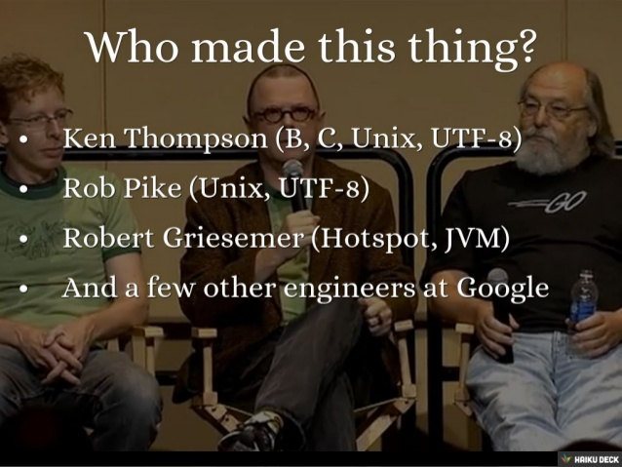
Go was invented by geniuses

Slide 3
performant
multiple-cores
concurrency
compiled
network

Slide 4
clean syntax
powerful standard library
garbage collected

Slide 5
portable
compiles on many OS’s
Notes:
http://www.infoworld.com/article/2896575/google-go/googles-go-language-pros-and-cons.html

Slide 6
backed by Google

Slide 7
open source

Slide 8
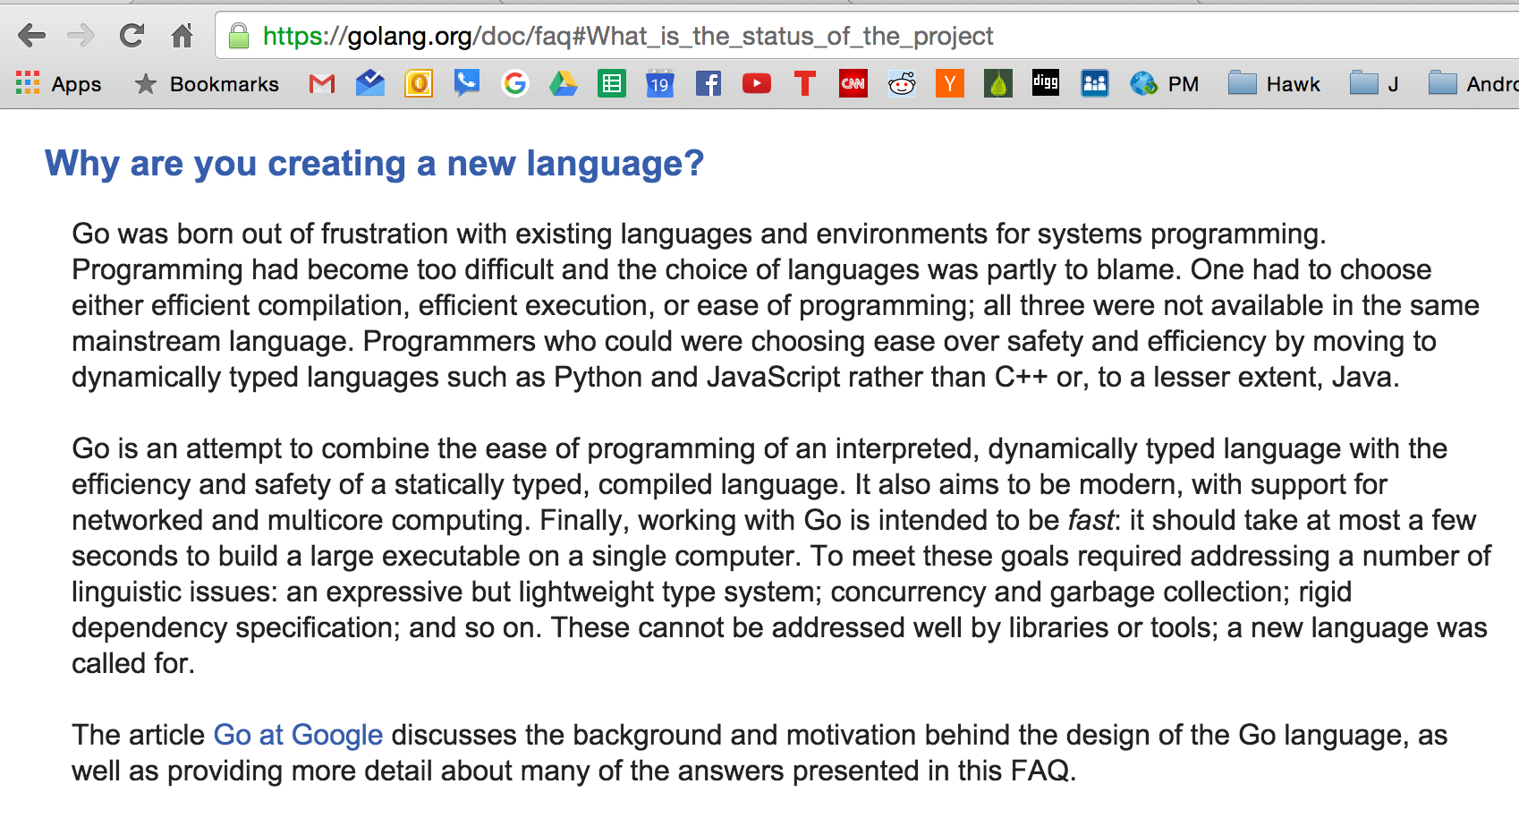

Slide 9
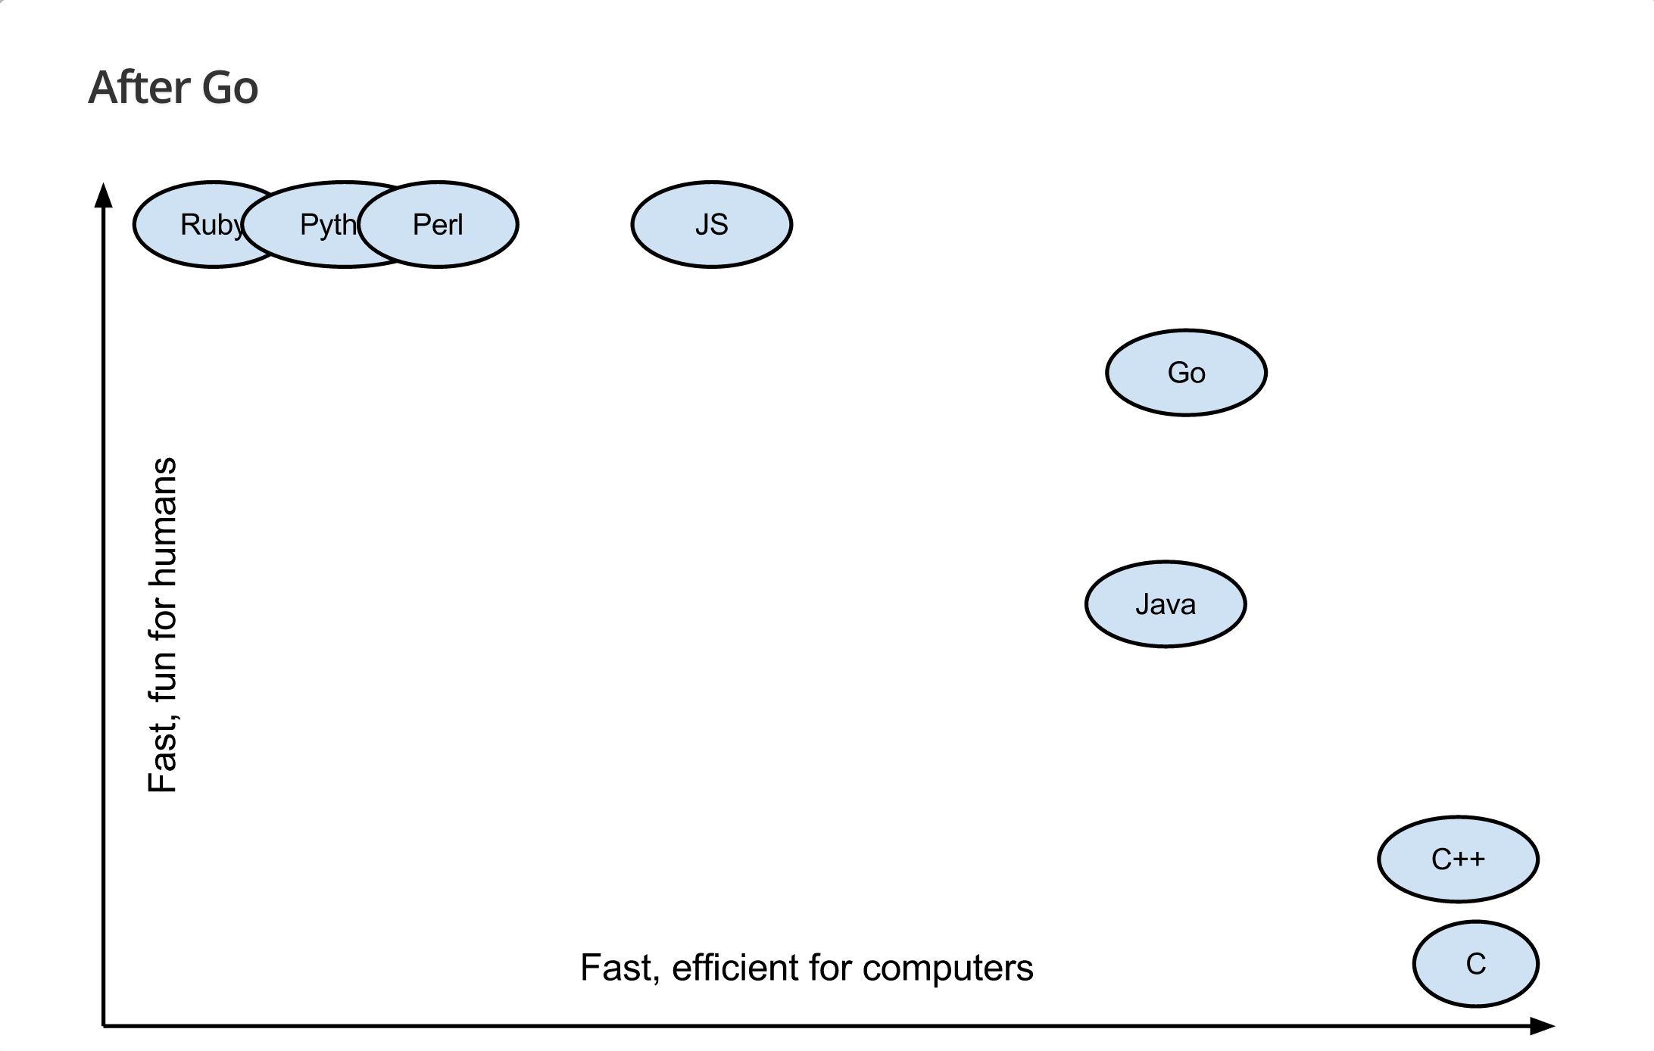
source: Brad Fitzpatrick
Notes:
"GoCon Tokyo" ~ May 31, 2014 ~ Brad Fitzpatrick

Slide 10
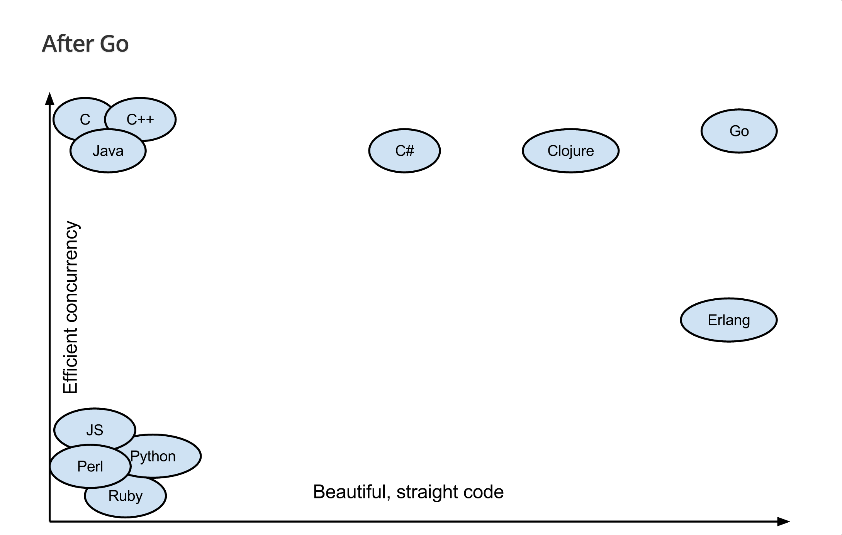
source: Brad Fitzpatrick
Notes:
"GoCon Tokyo" ~ May 31, 2014 ~ Brad Fitzpatrick

Slide 11
“Go has its own elegance and programming idioms that make the language productive and fun to code. The language designers set out to create a language that would let them be productive without losing access to the lower-level programming constructs they needed. This balance is achieved through a minimized set of keywords, built-in functions, and syntax. Go also provides a comprehensive standard library. The standard library provides all the core packages programmers need to build real-world web and network based programs.”
~ Bill Kennedy, Go In Action

Slide 12
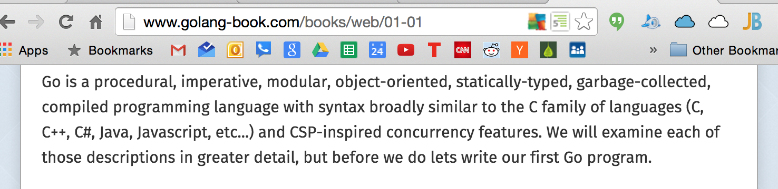
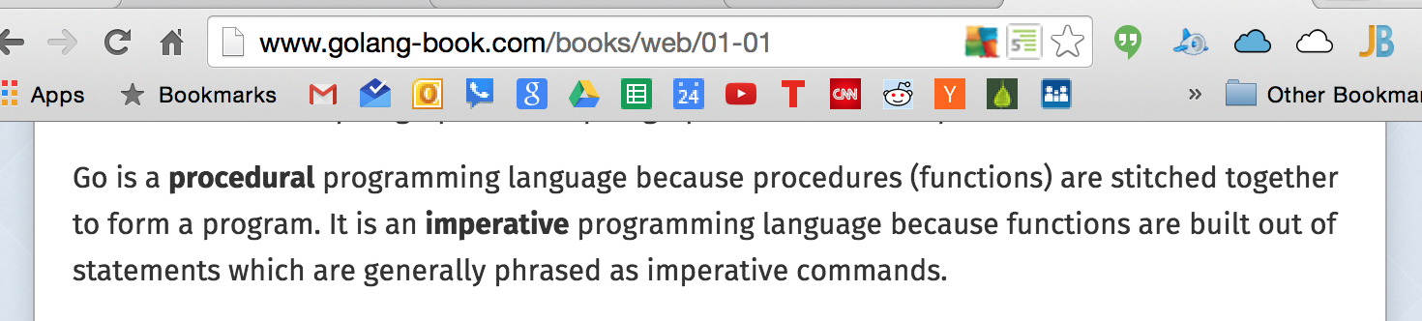

Slide 13
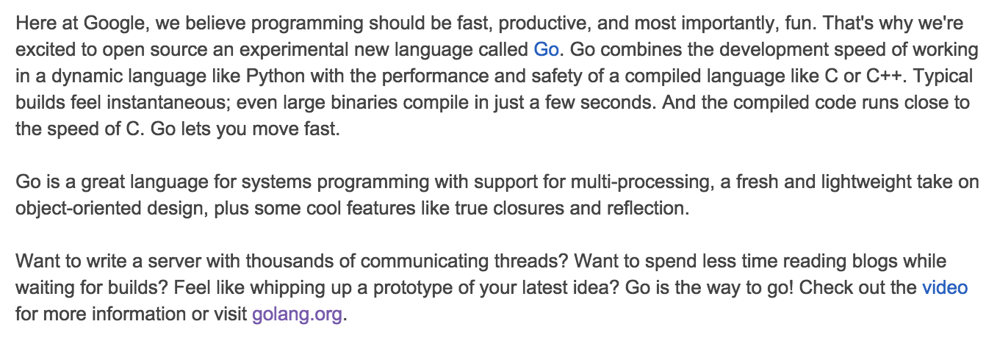
http://google-opensource.blogspot.com/2009/11/hey-ho-lets-go.html

Slide 14
companies using Go

Slide 15


Slide 16


Slide 17


Slide 18


Slide 19






















Slide 20


Slide 21


Slide 22


Slide 23


Slide 24


Slide 25

Notes:
https://www.youtube.com/watch?v=bAQ9ShmXYLY

Slide 26


Slide 27


Slide 28


Slide 29


Slide 30


Slide 31
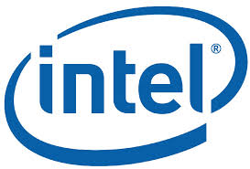

Slide 32


Slide 33


Slide 34


Slide 35
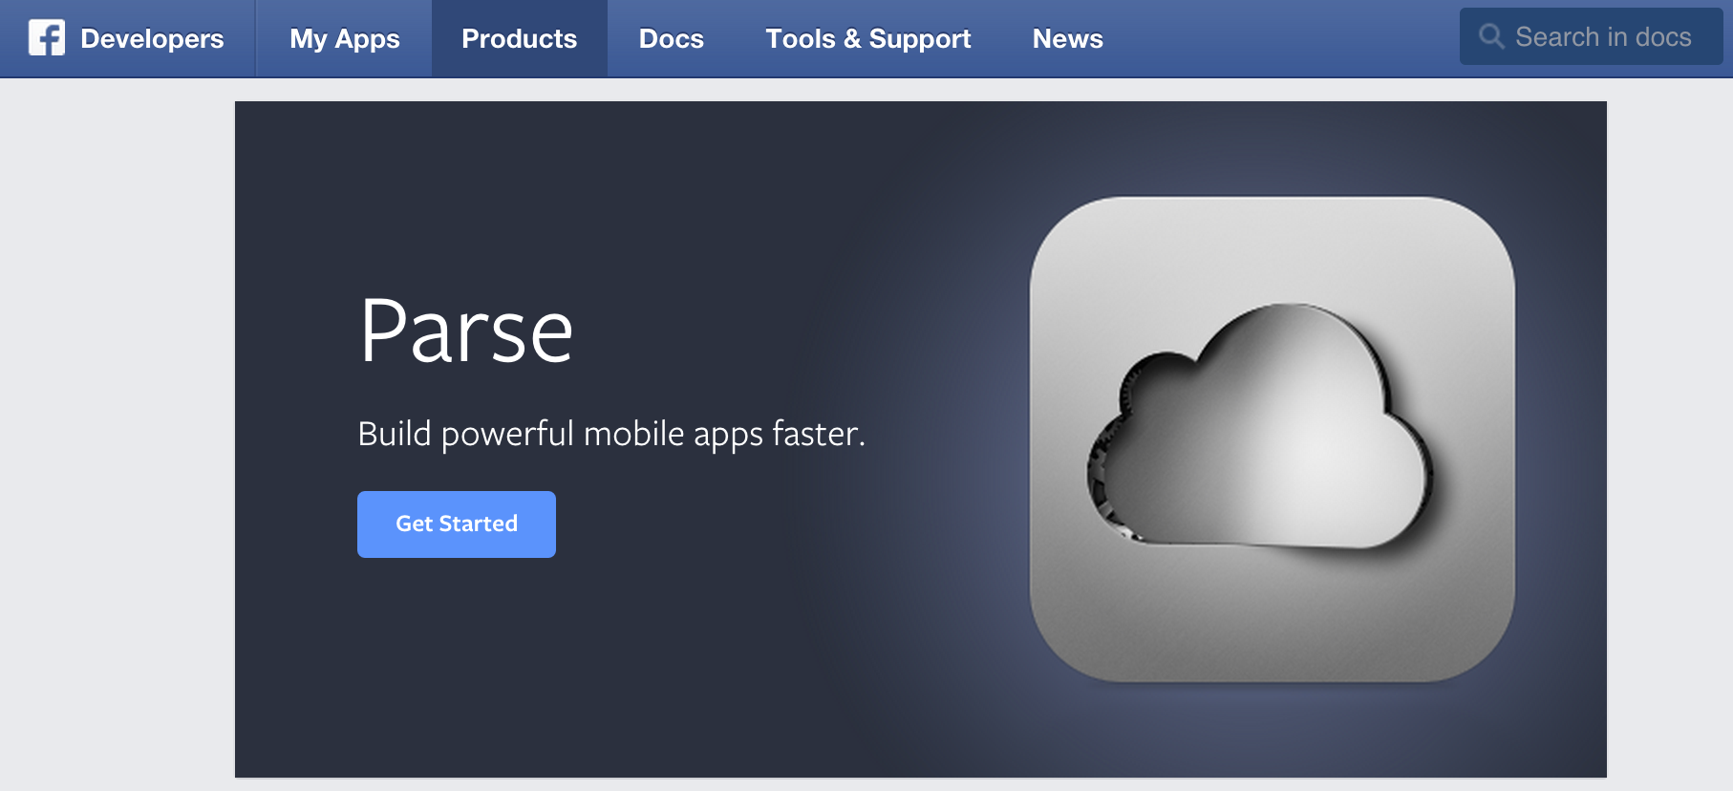

Slide 36


Slide 37
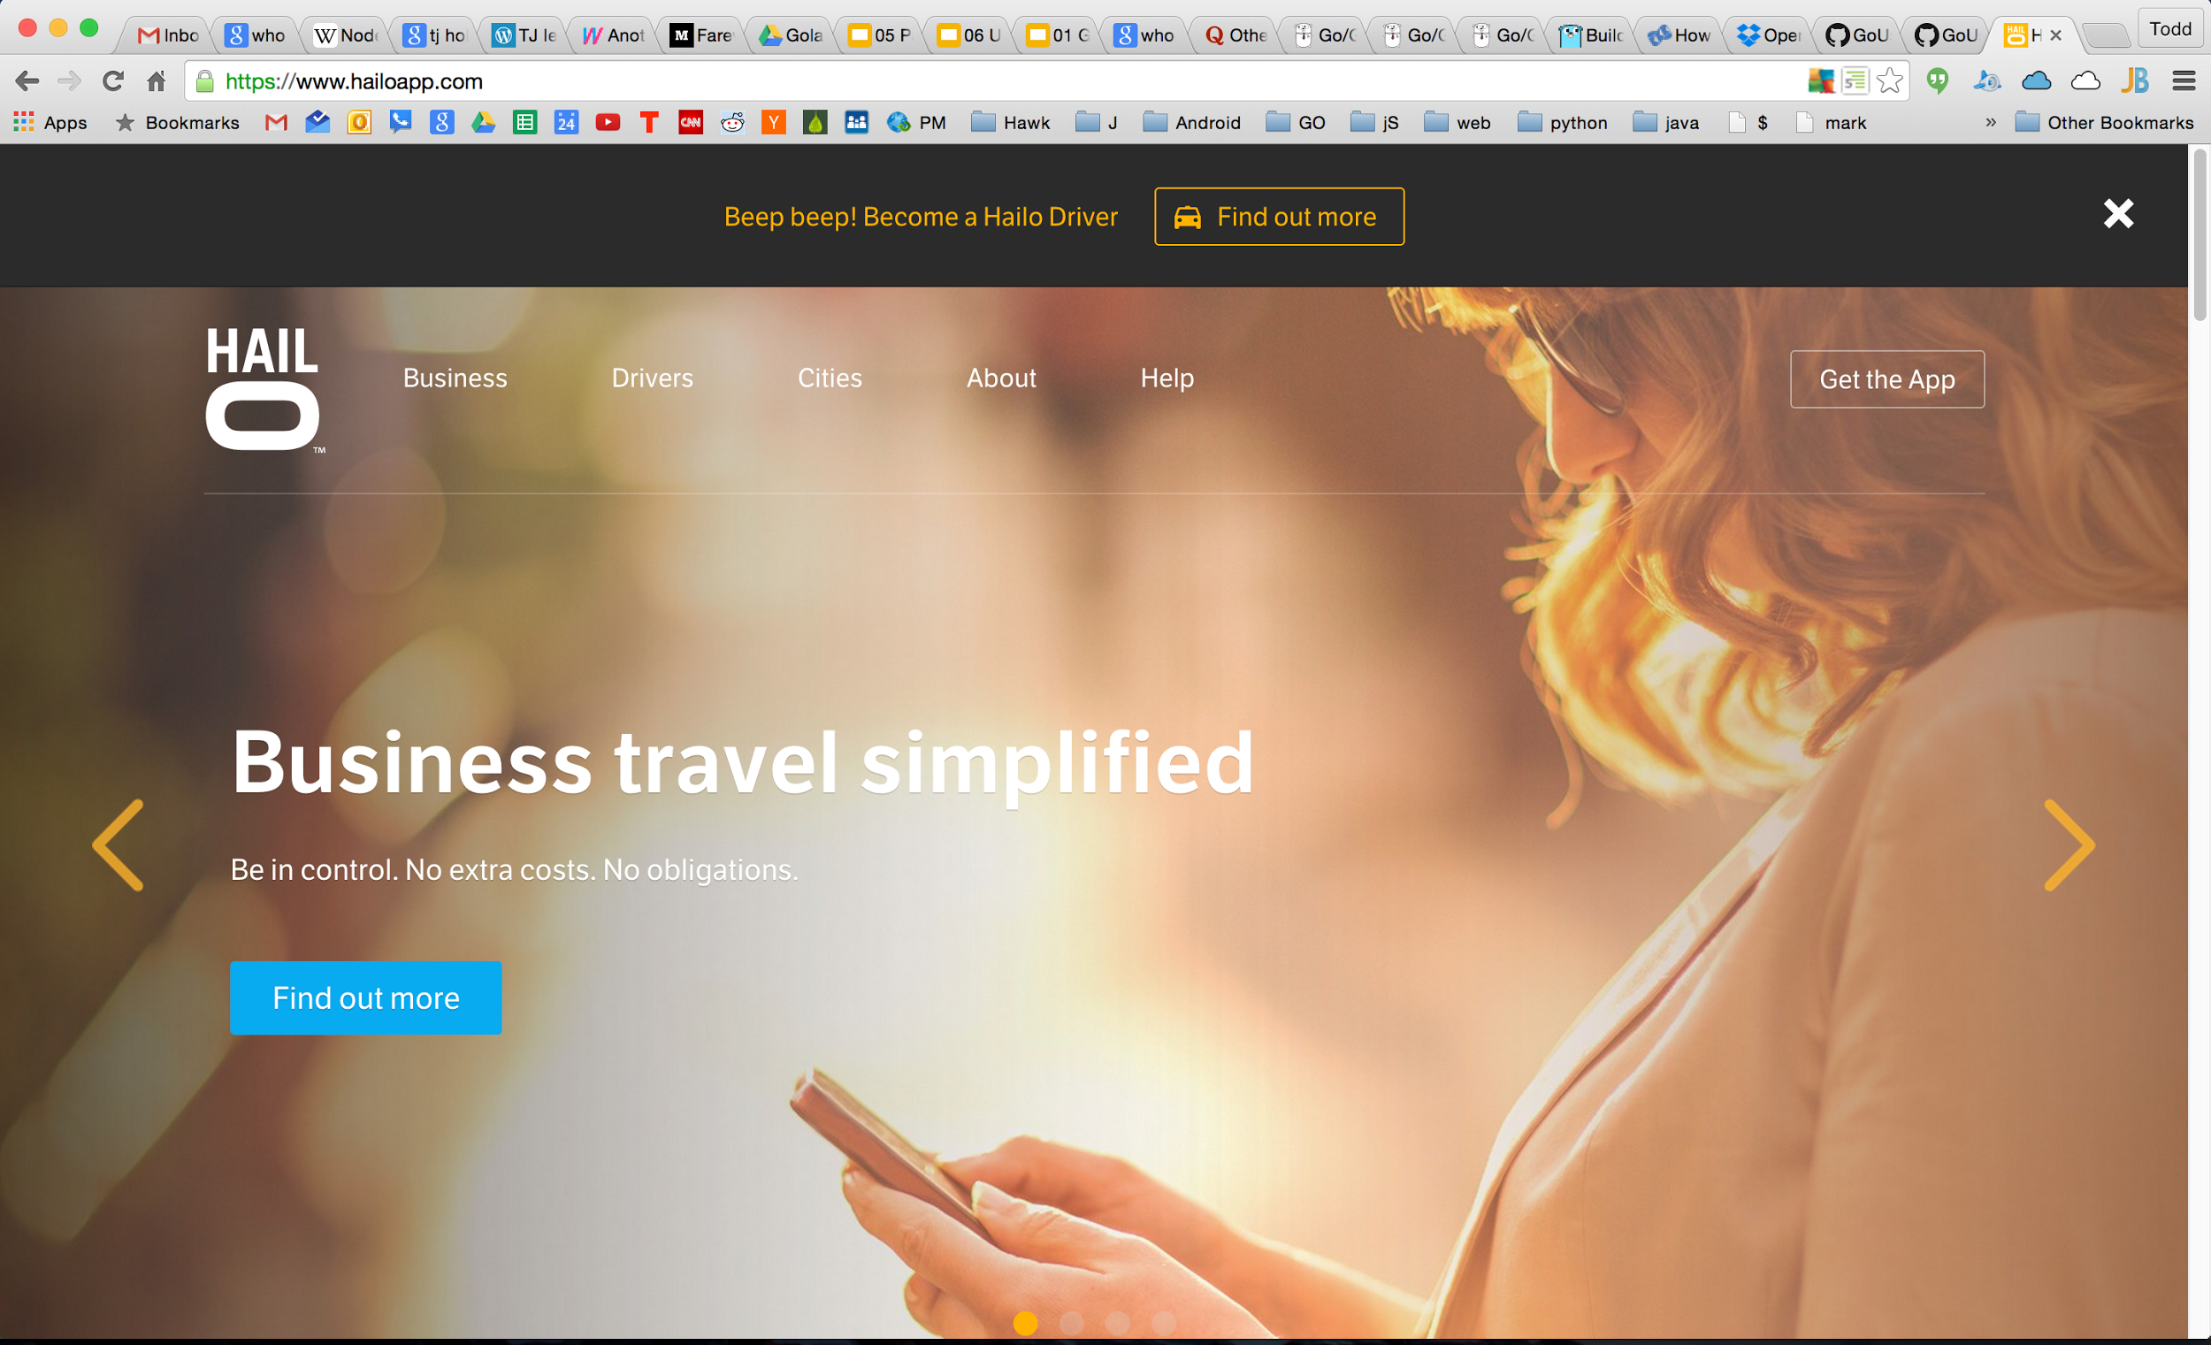

Slide 38


Slide 39
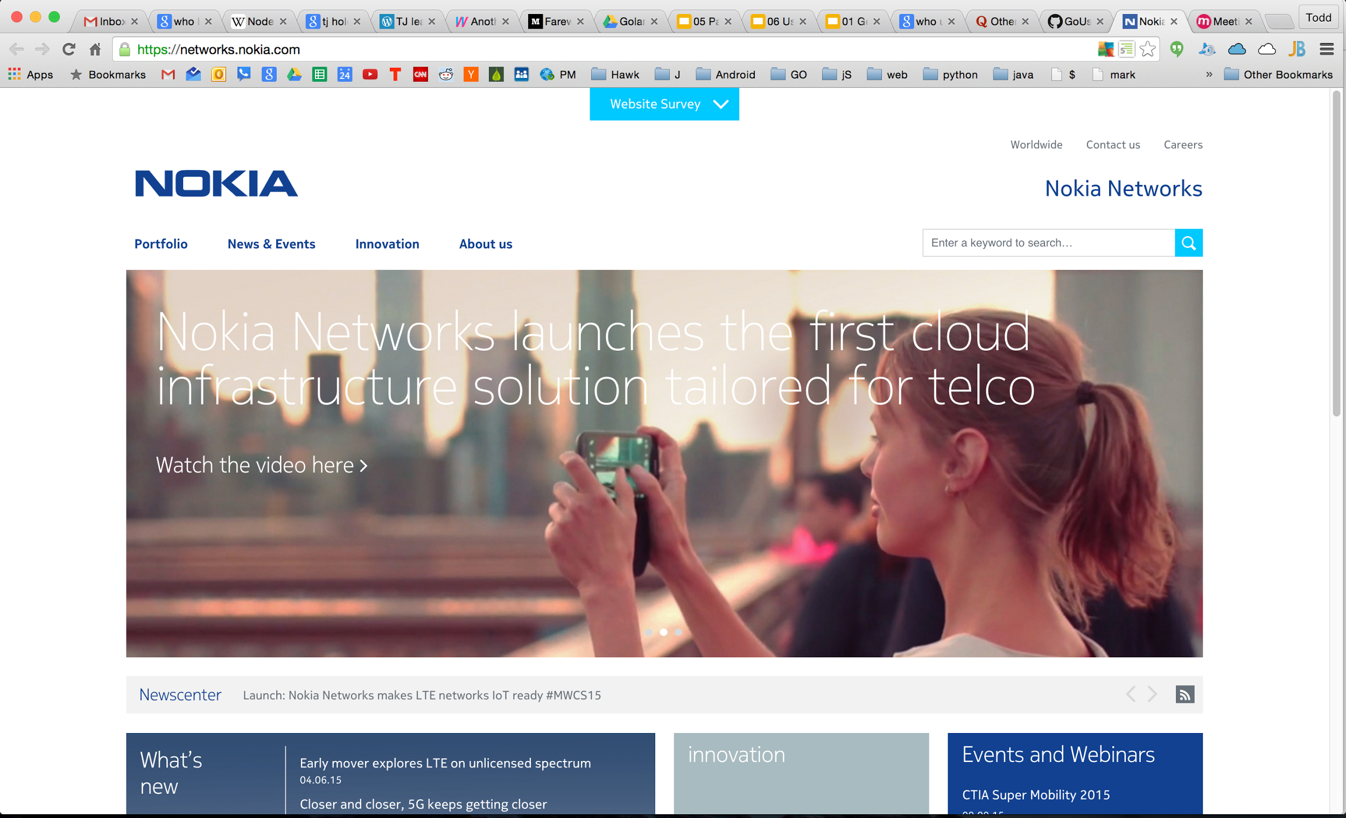

Slide 40
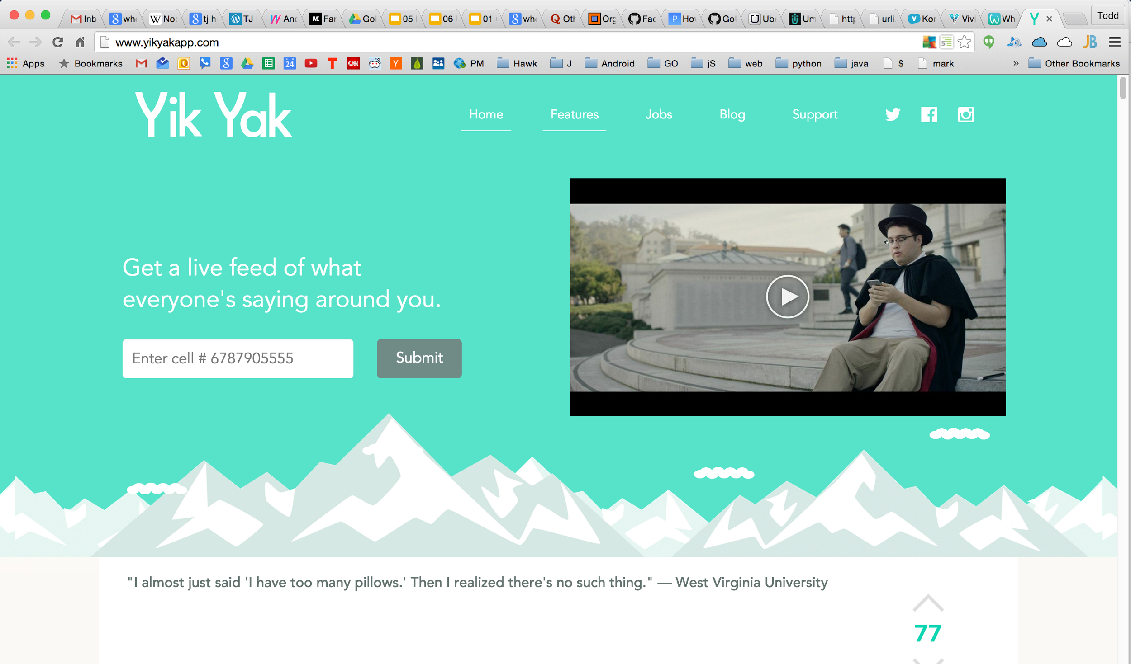

Slide 41
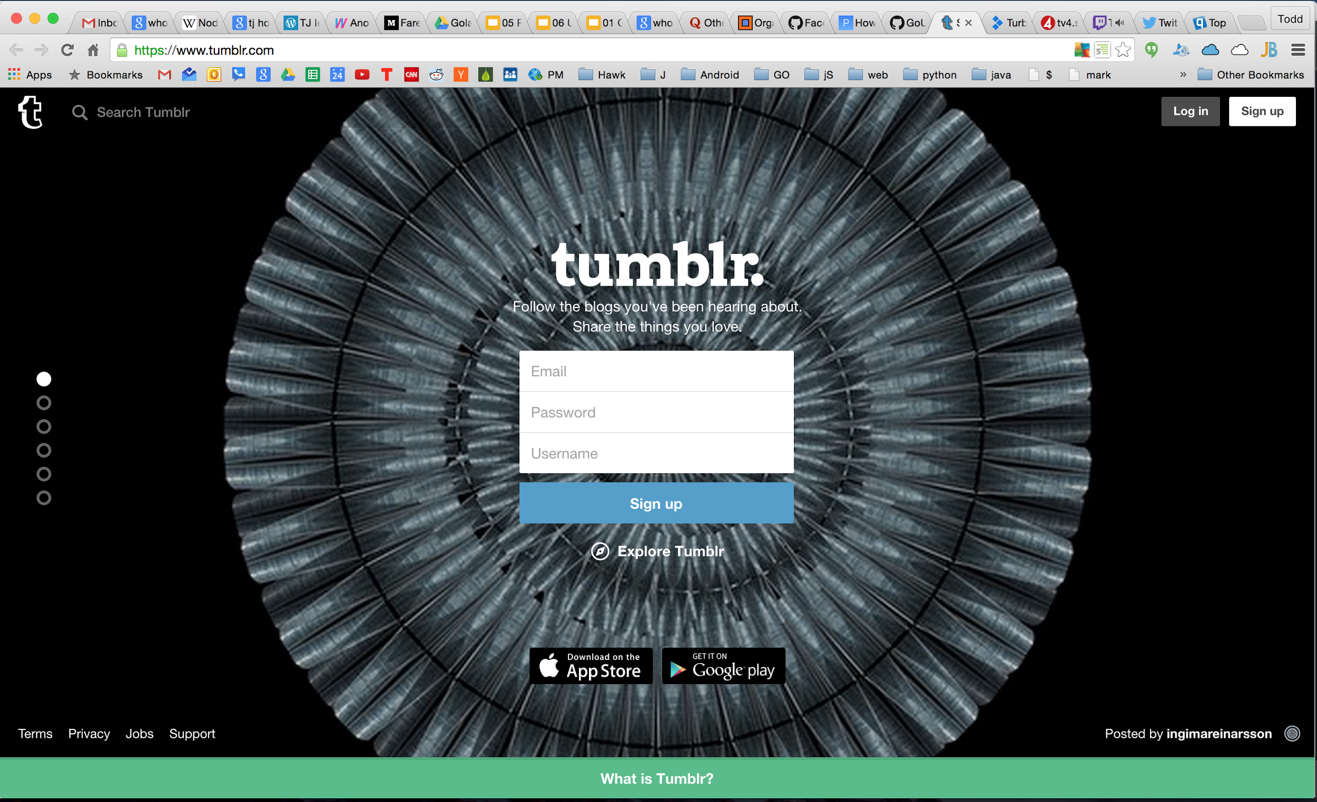

Slide 42


Slide 43


Slide 44
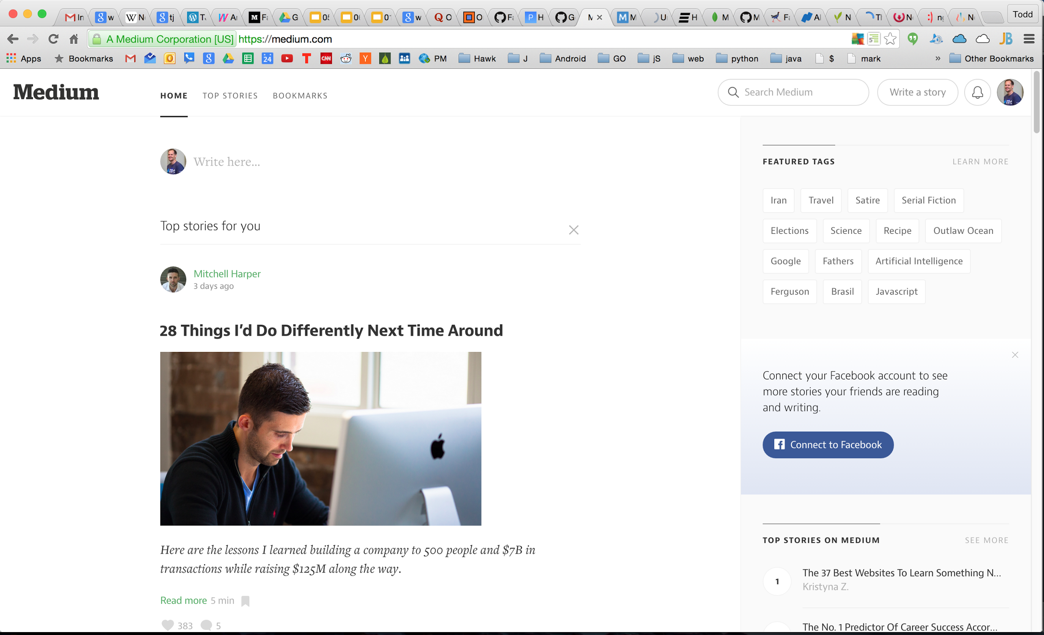

Slide 45


Slide 46


Slide 47


Slide 48
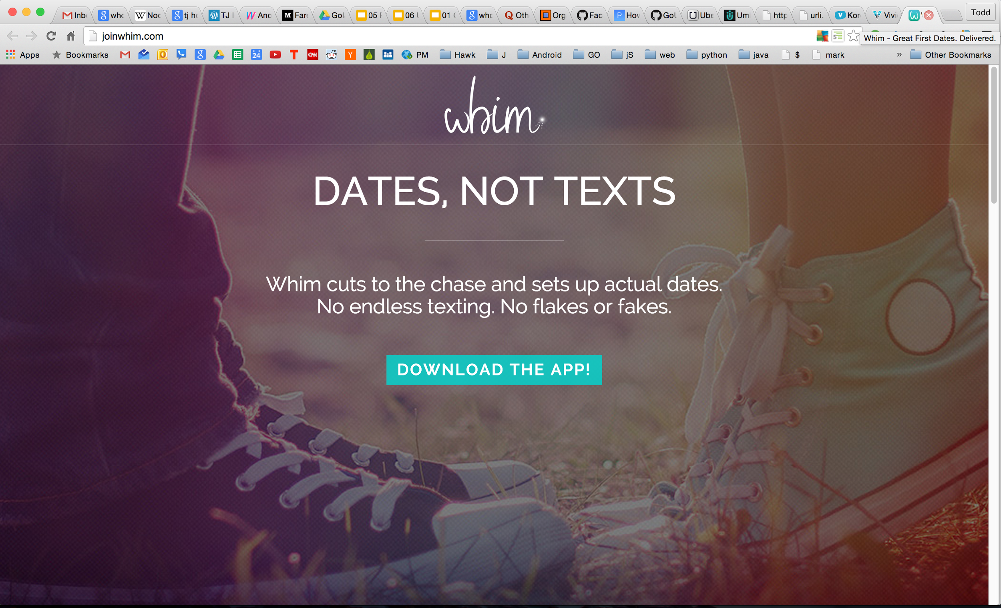

Slide 49


Slide 50
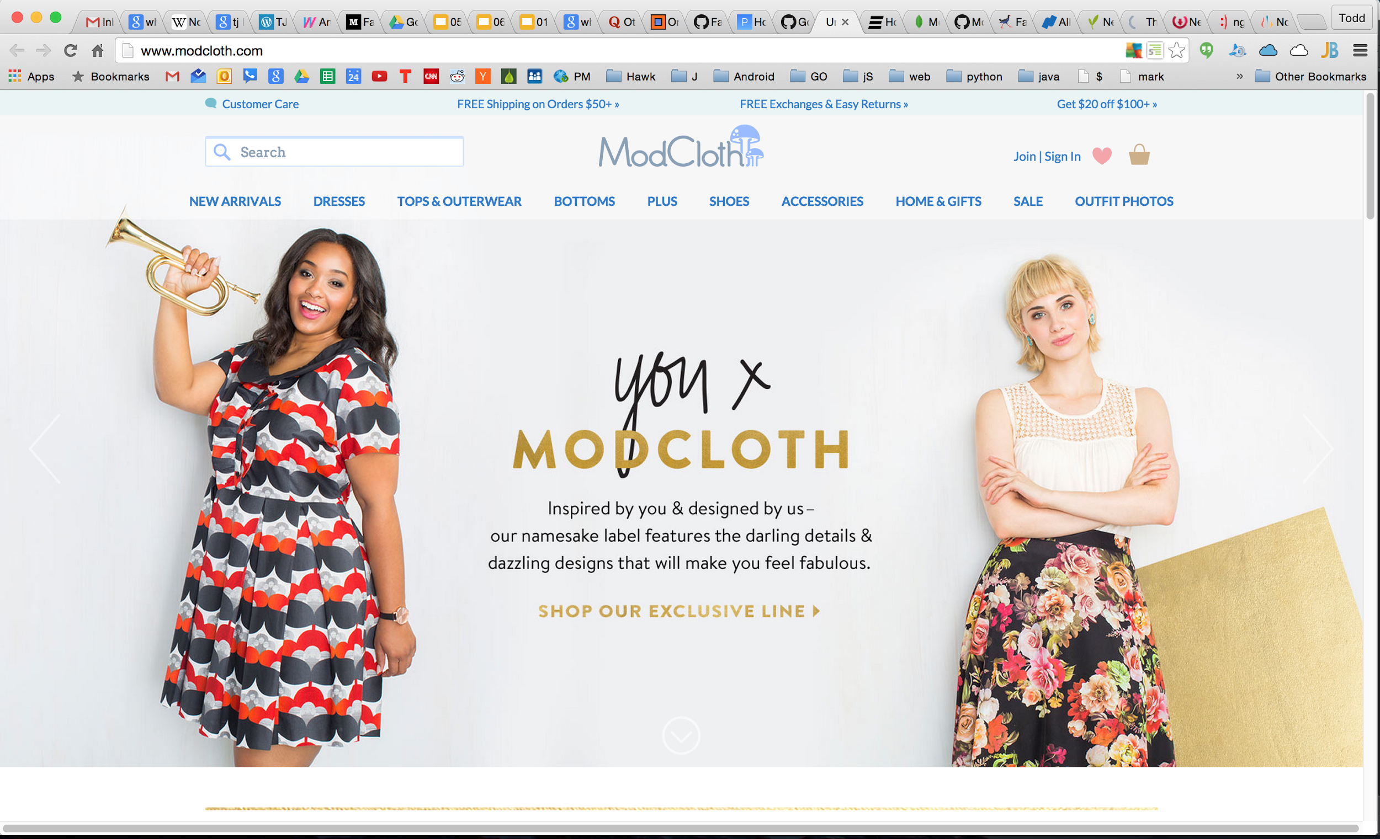

Slide 51
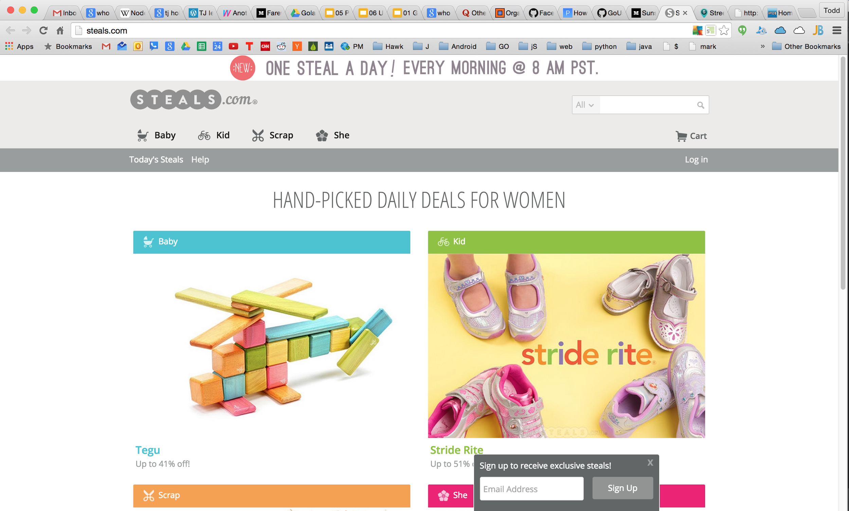

Slide 52
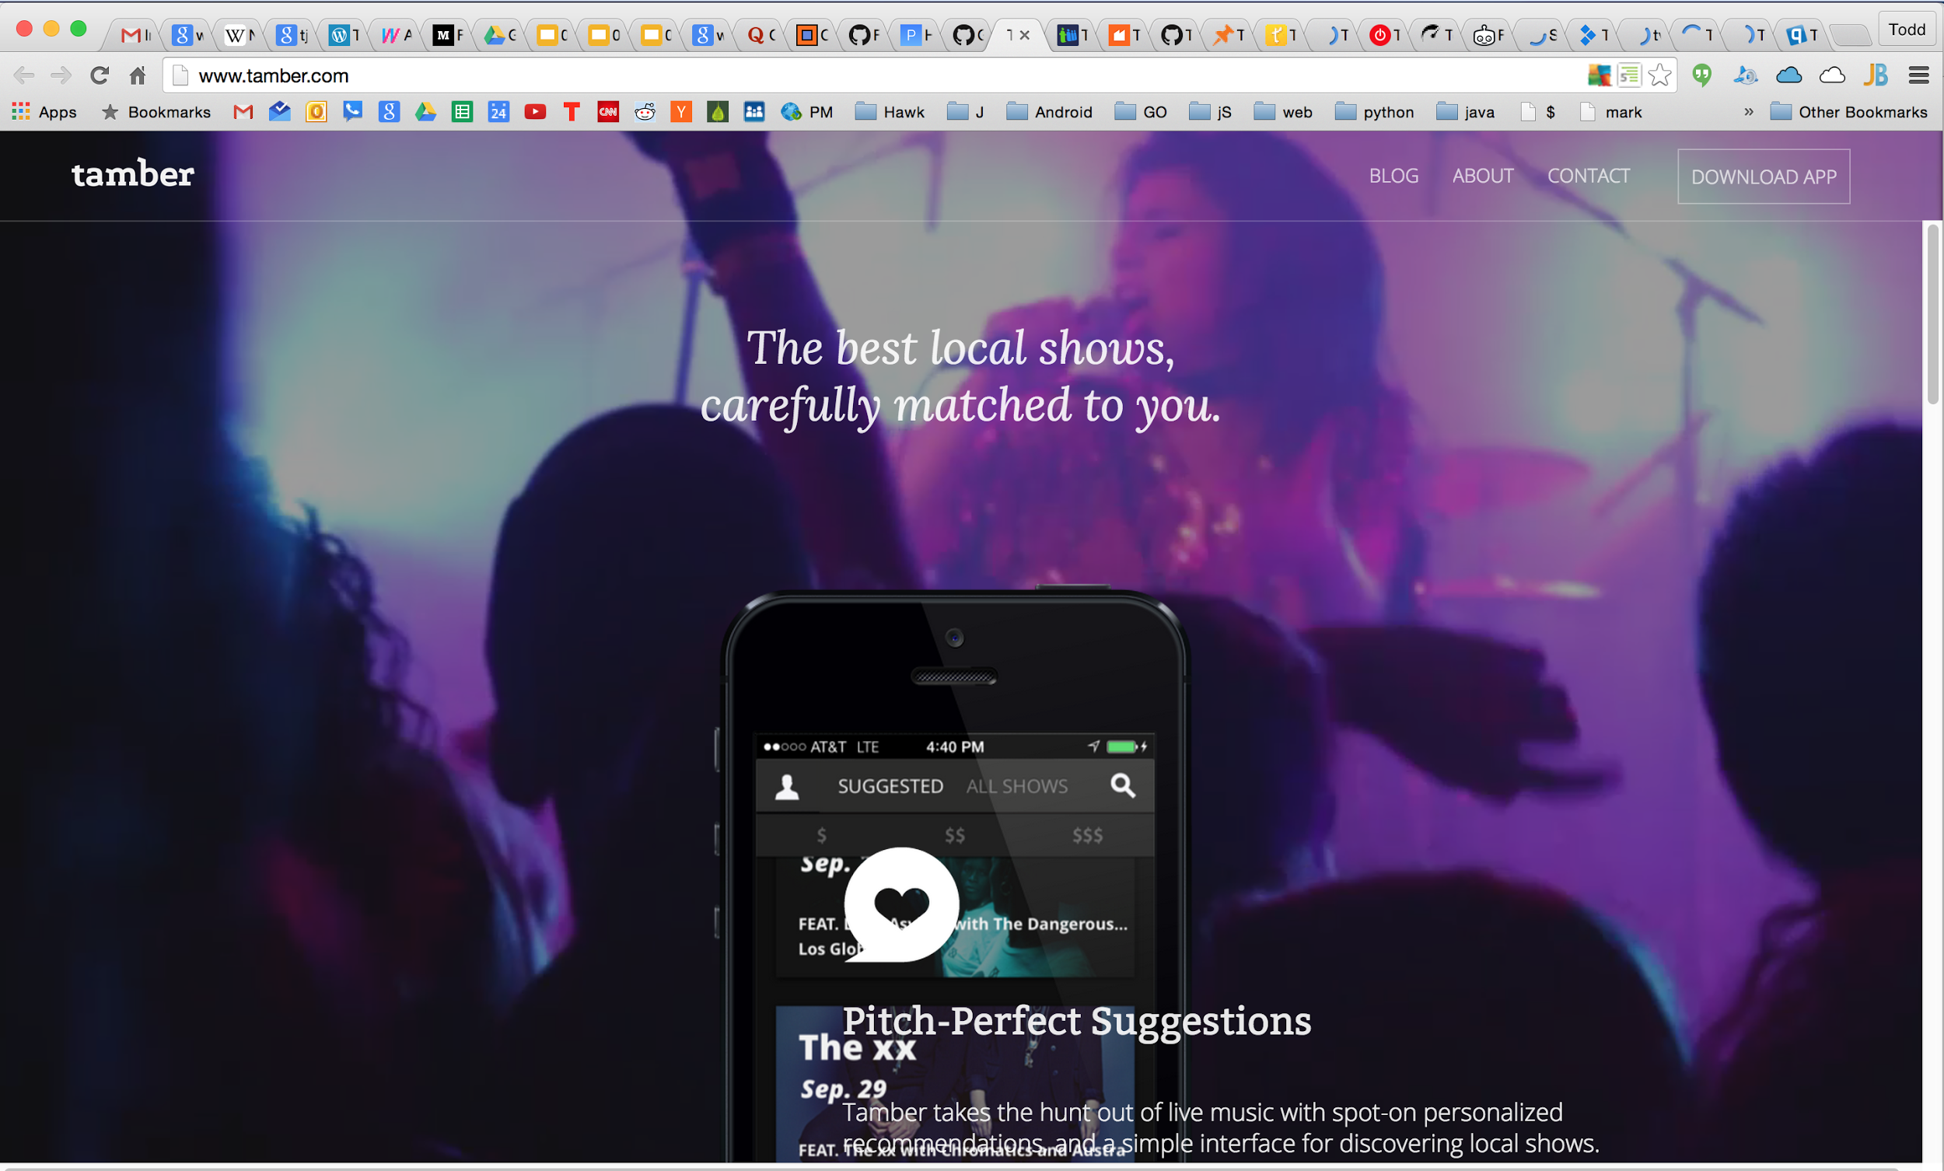

Slide 53


Slide 54
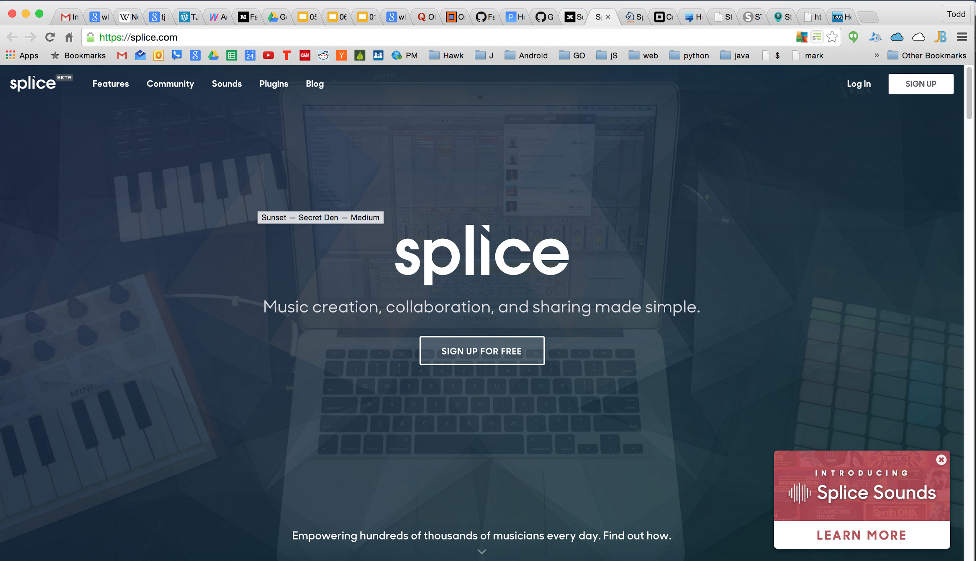

Slide 55
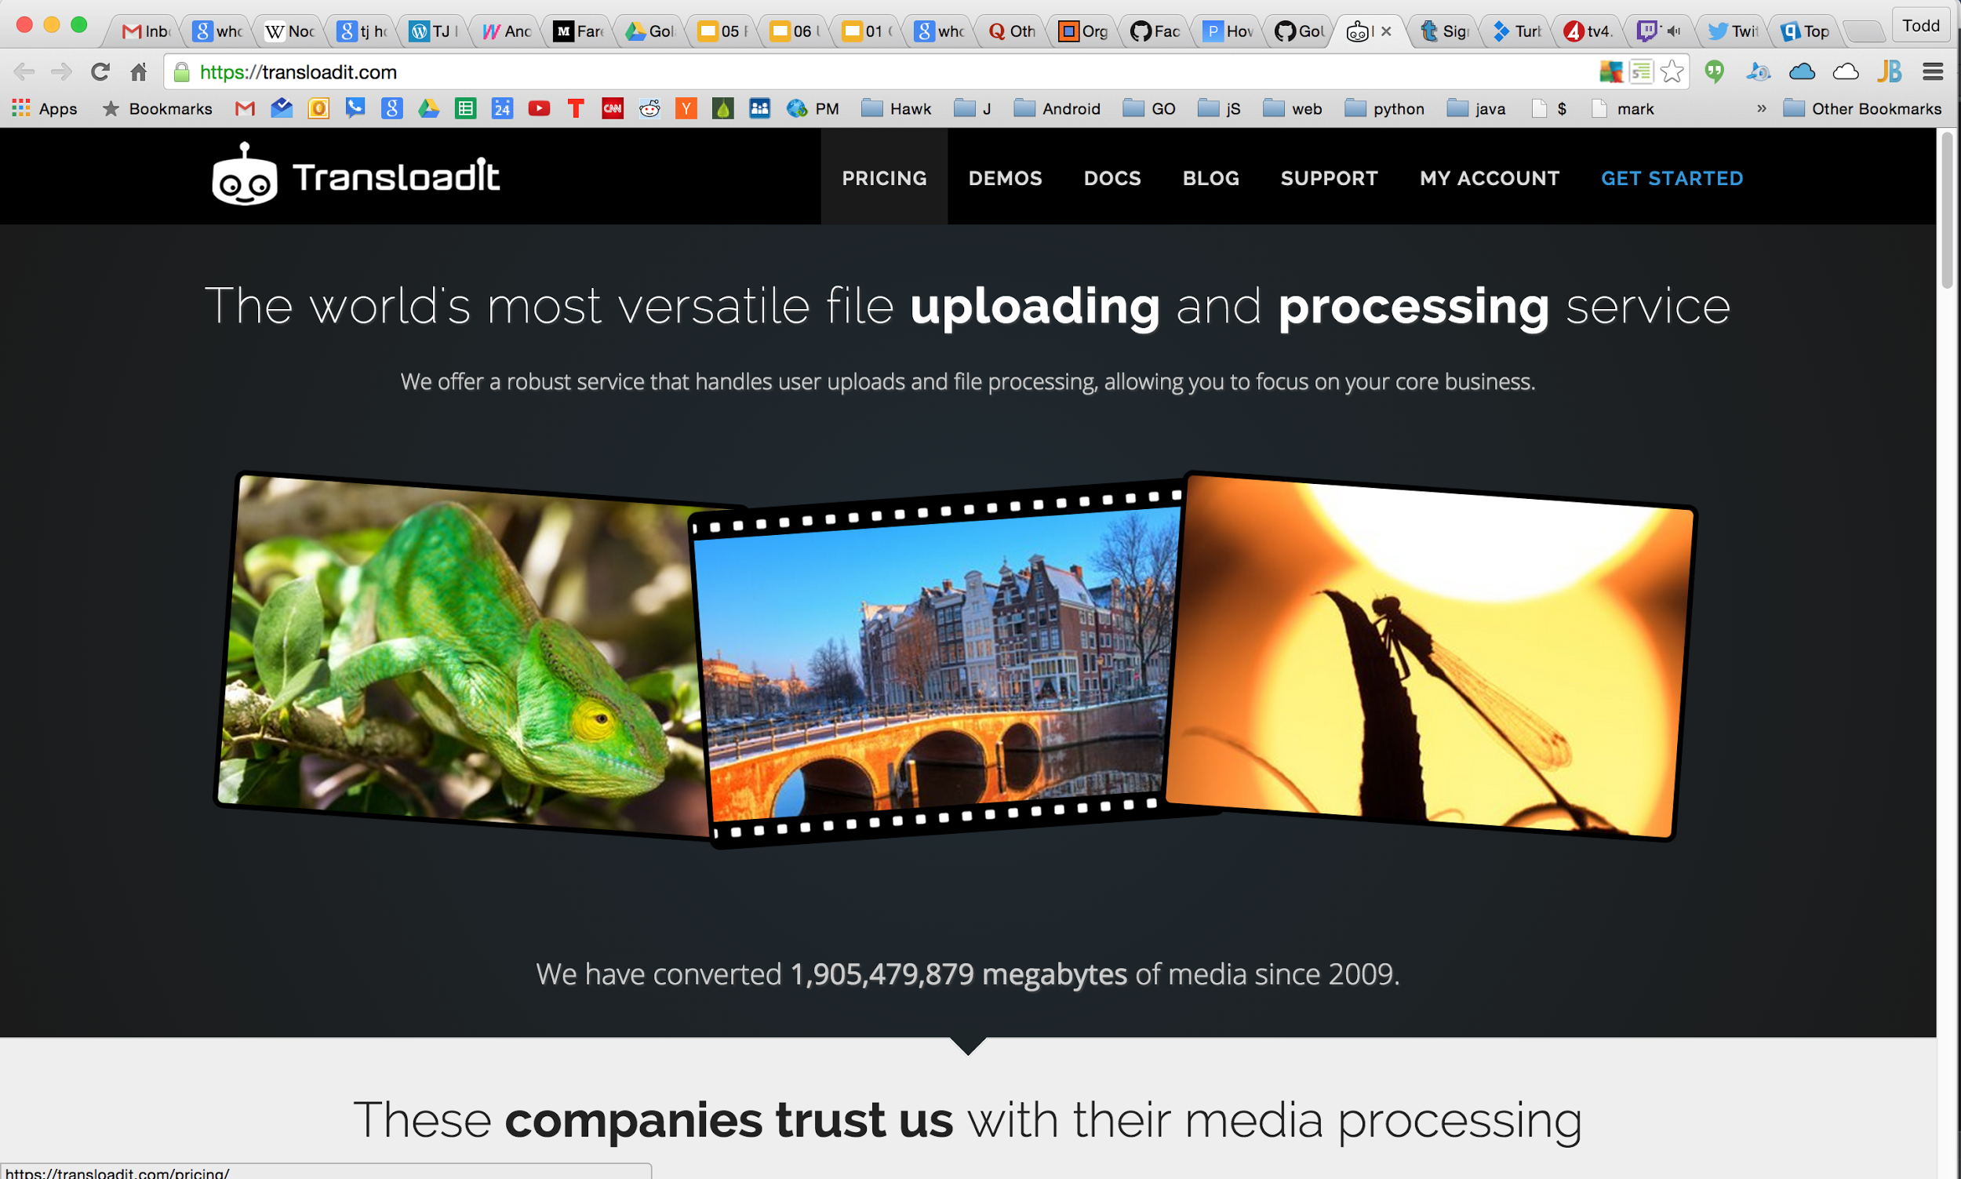

Slide 56


Slide 57


Slide 58
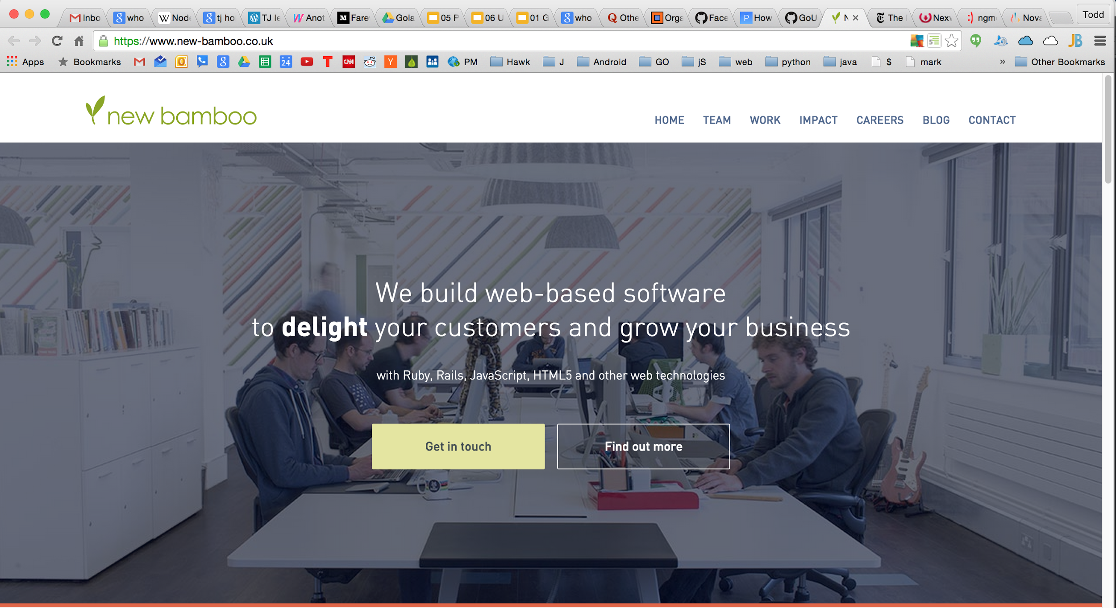

Slide 59
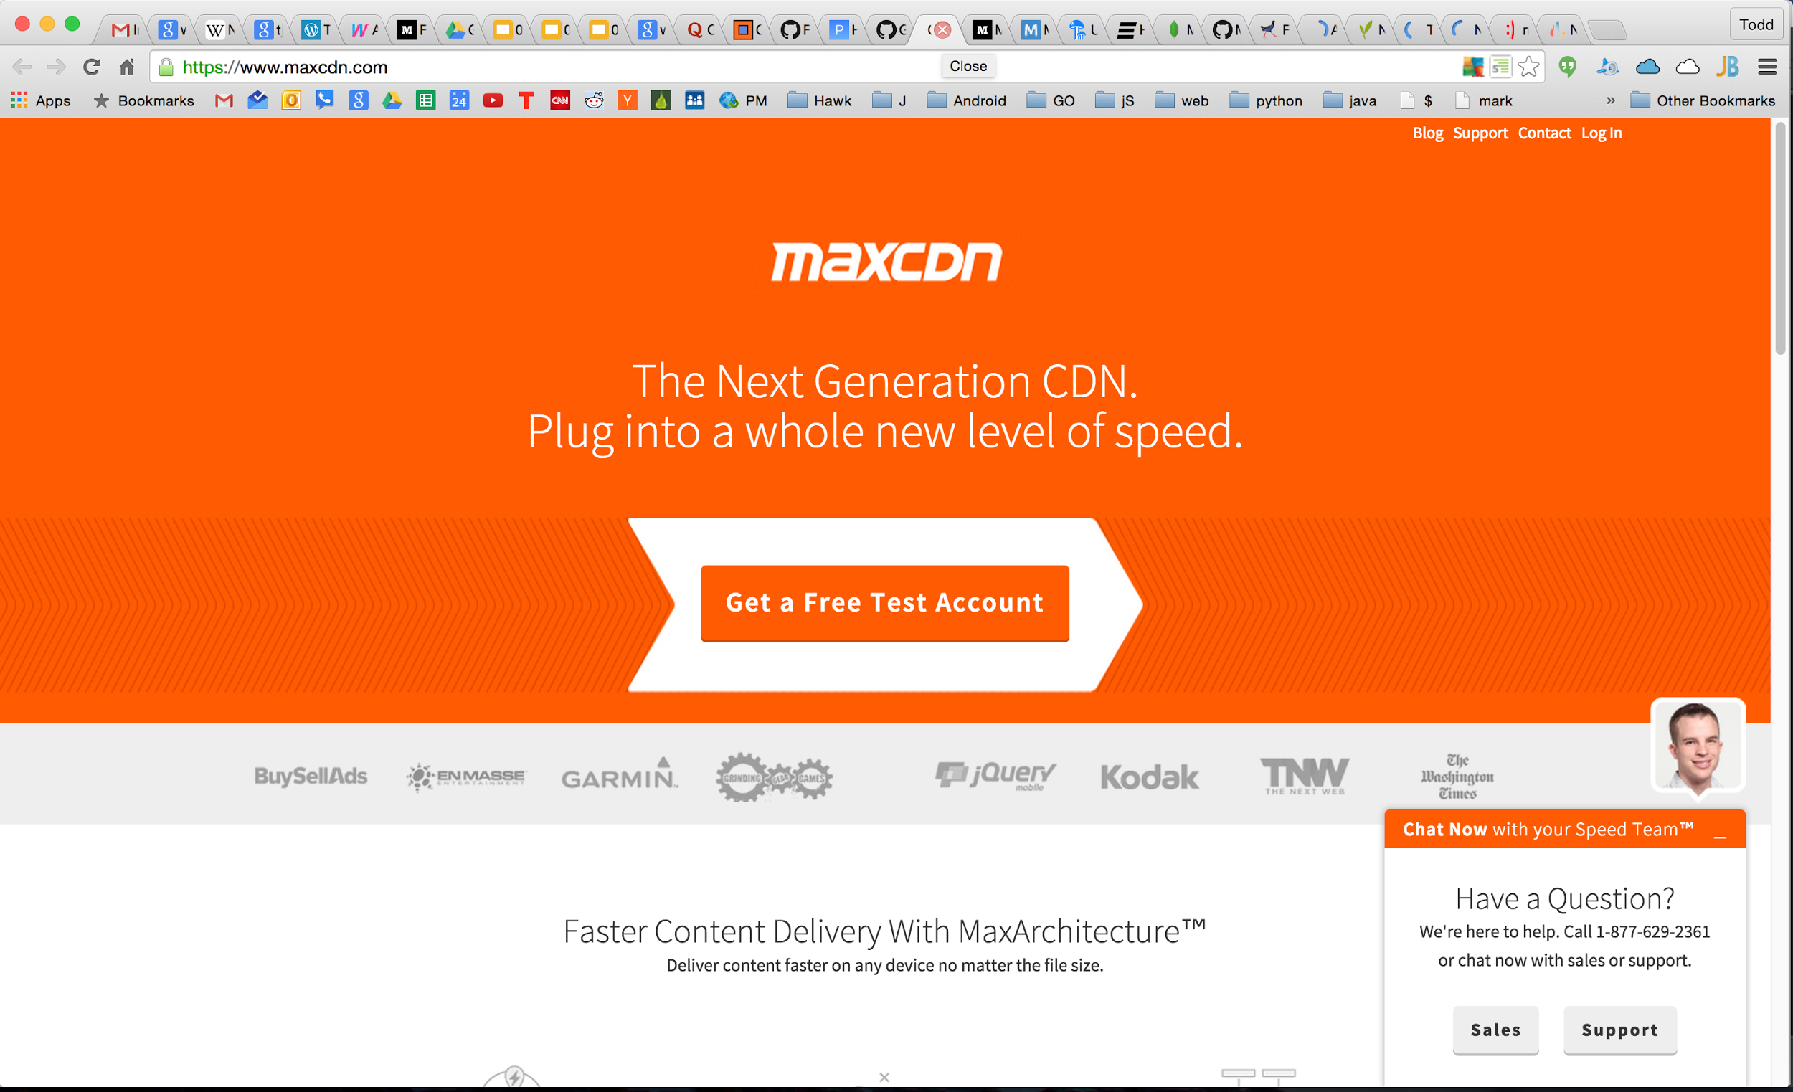

Slide 60


Slide 61


Slide 62
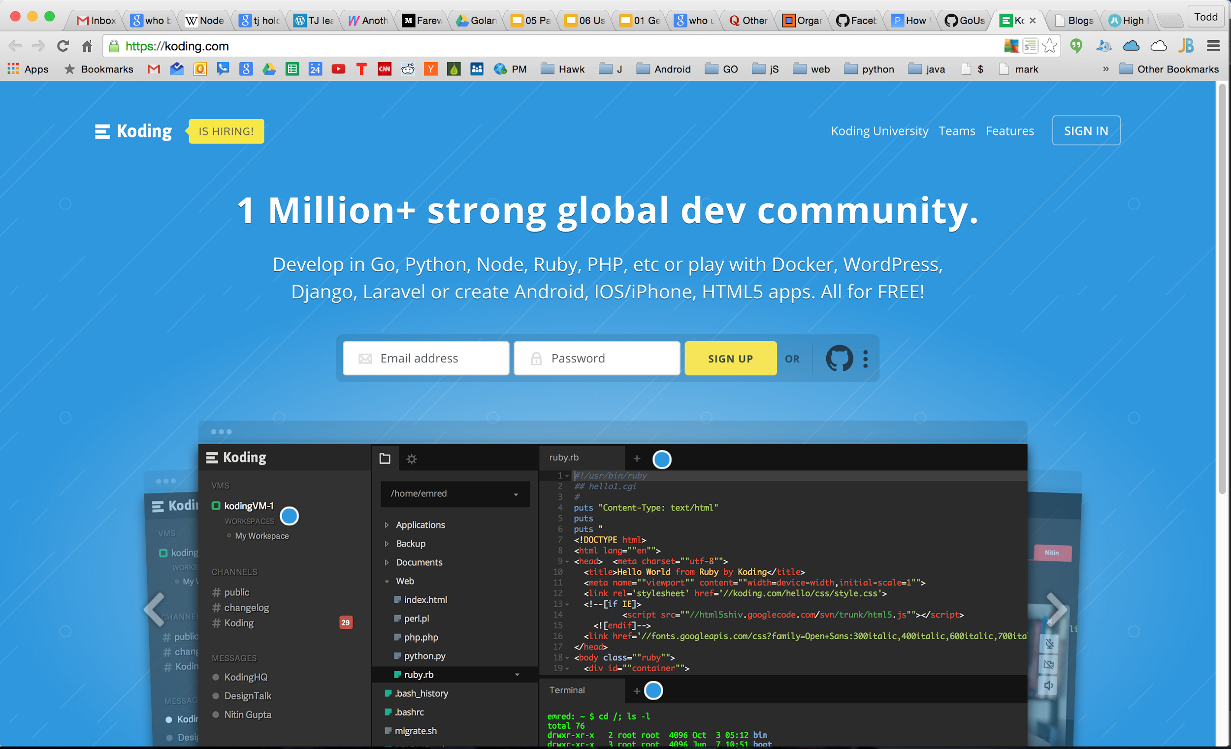

Slide 63


Slide 64
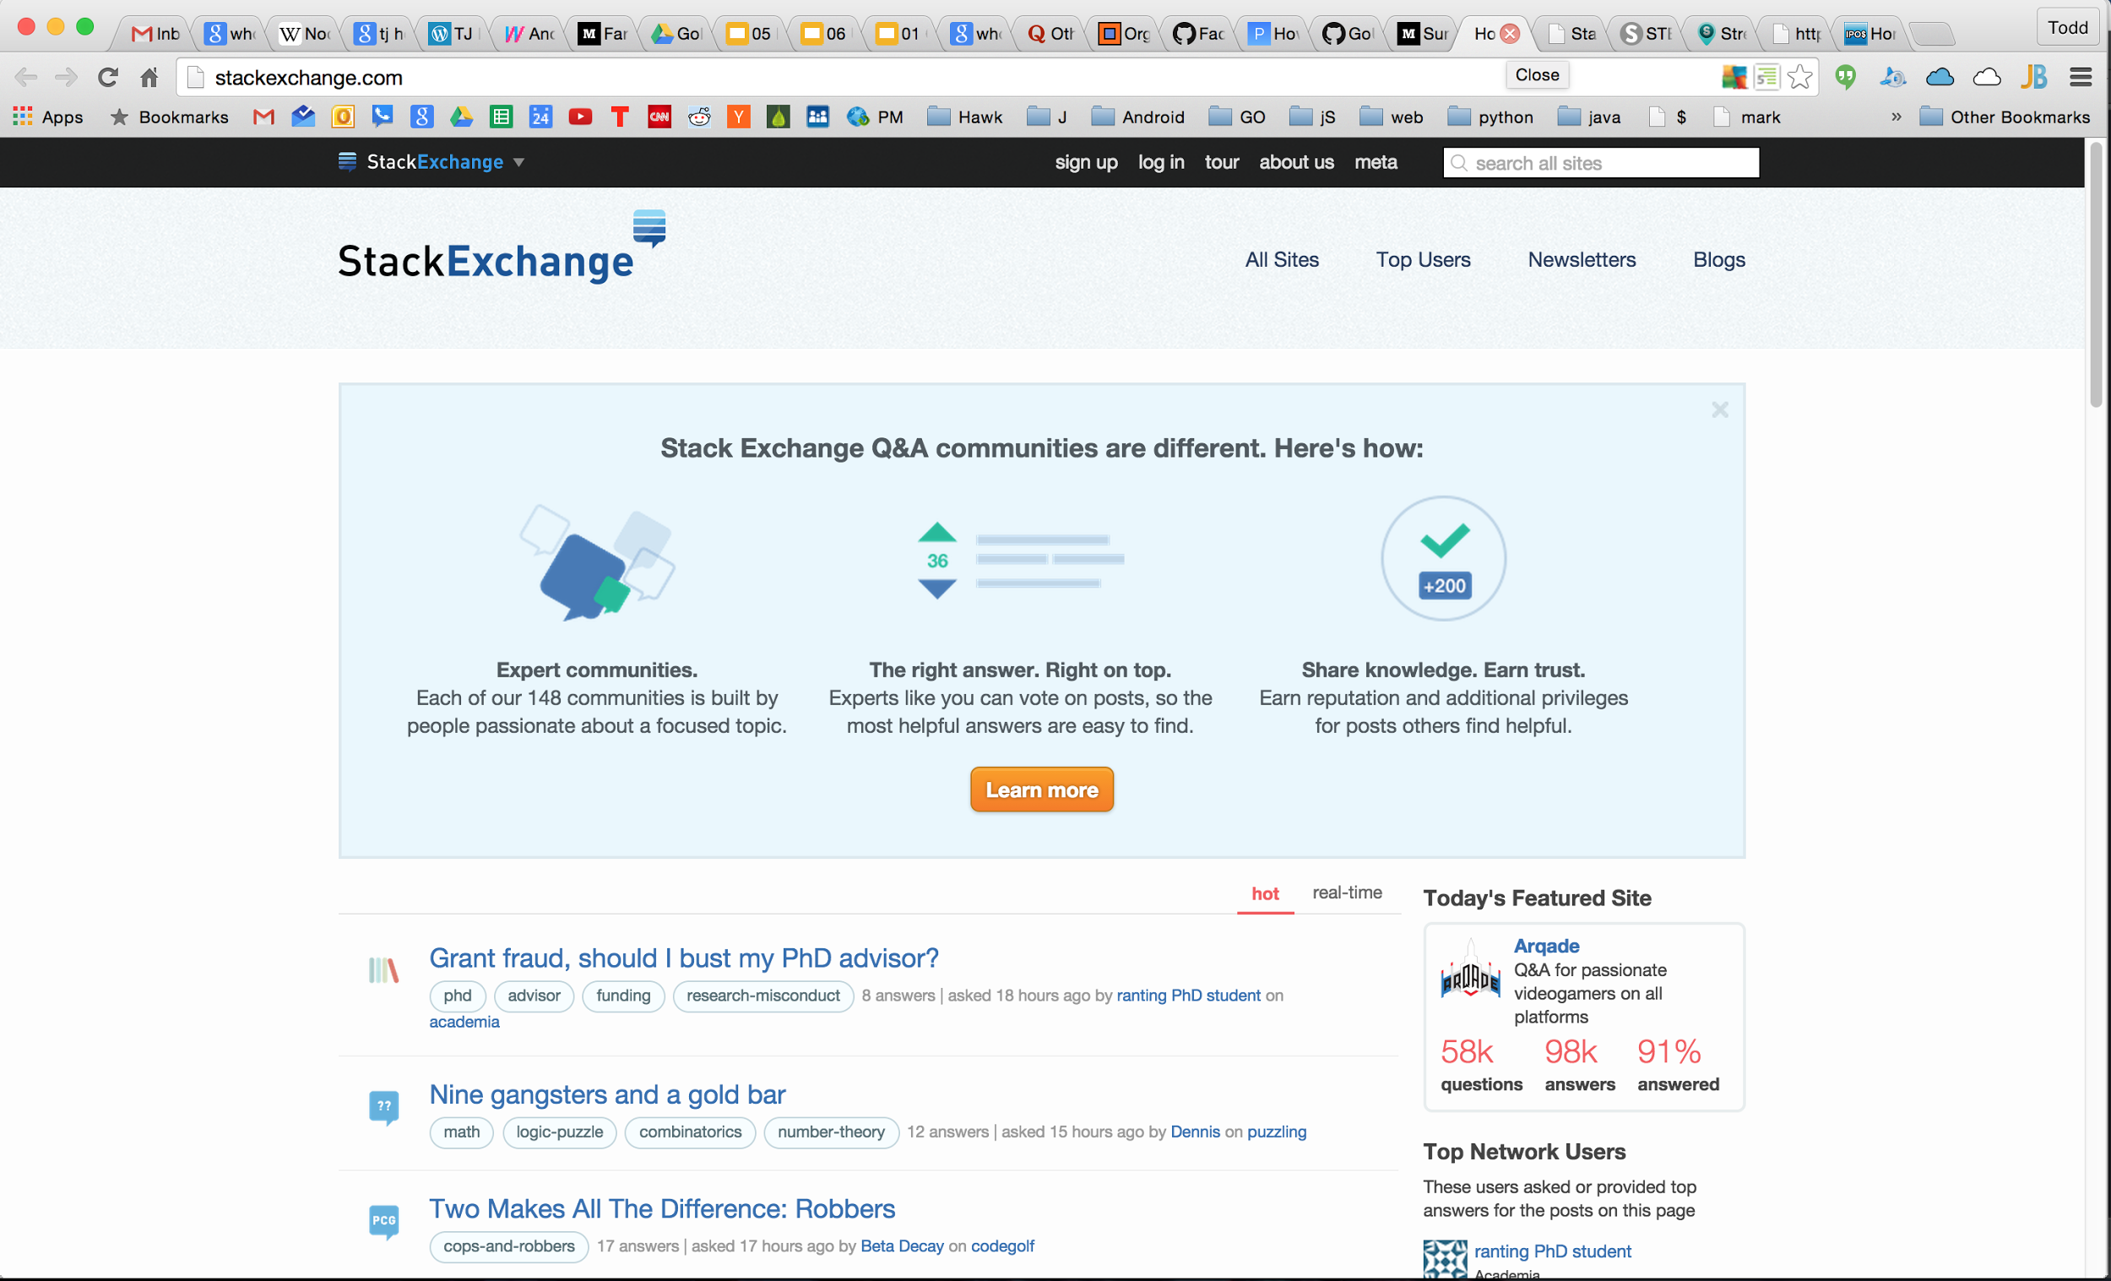

Slide 65
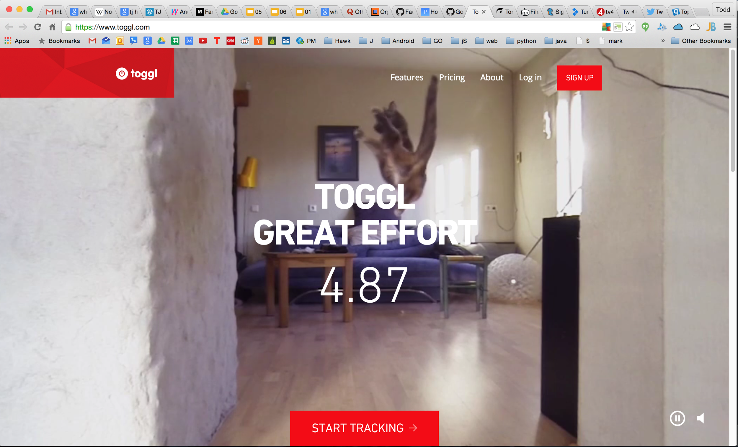

Slide 66


Slide 67
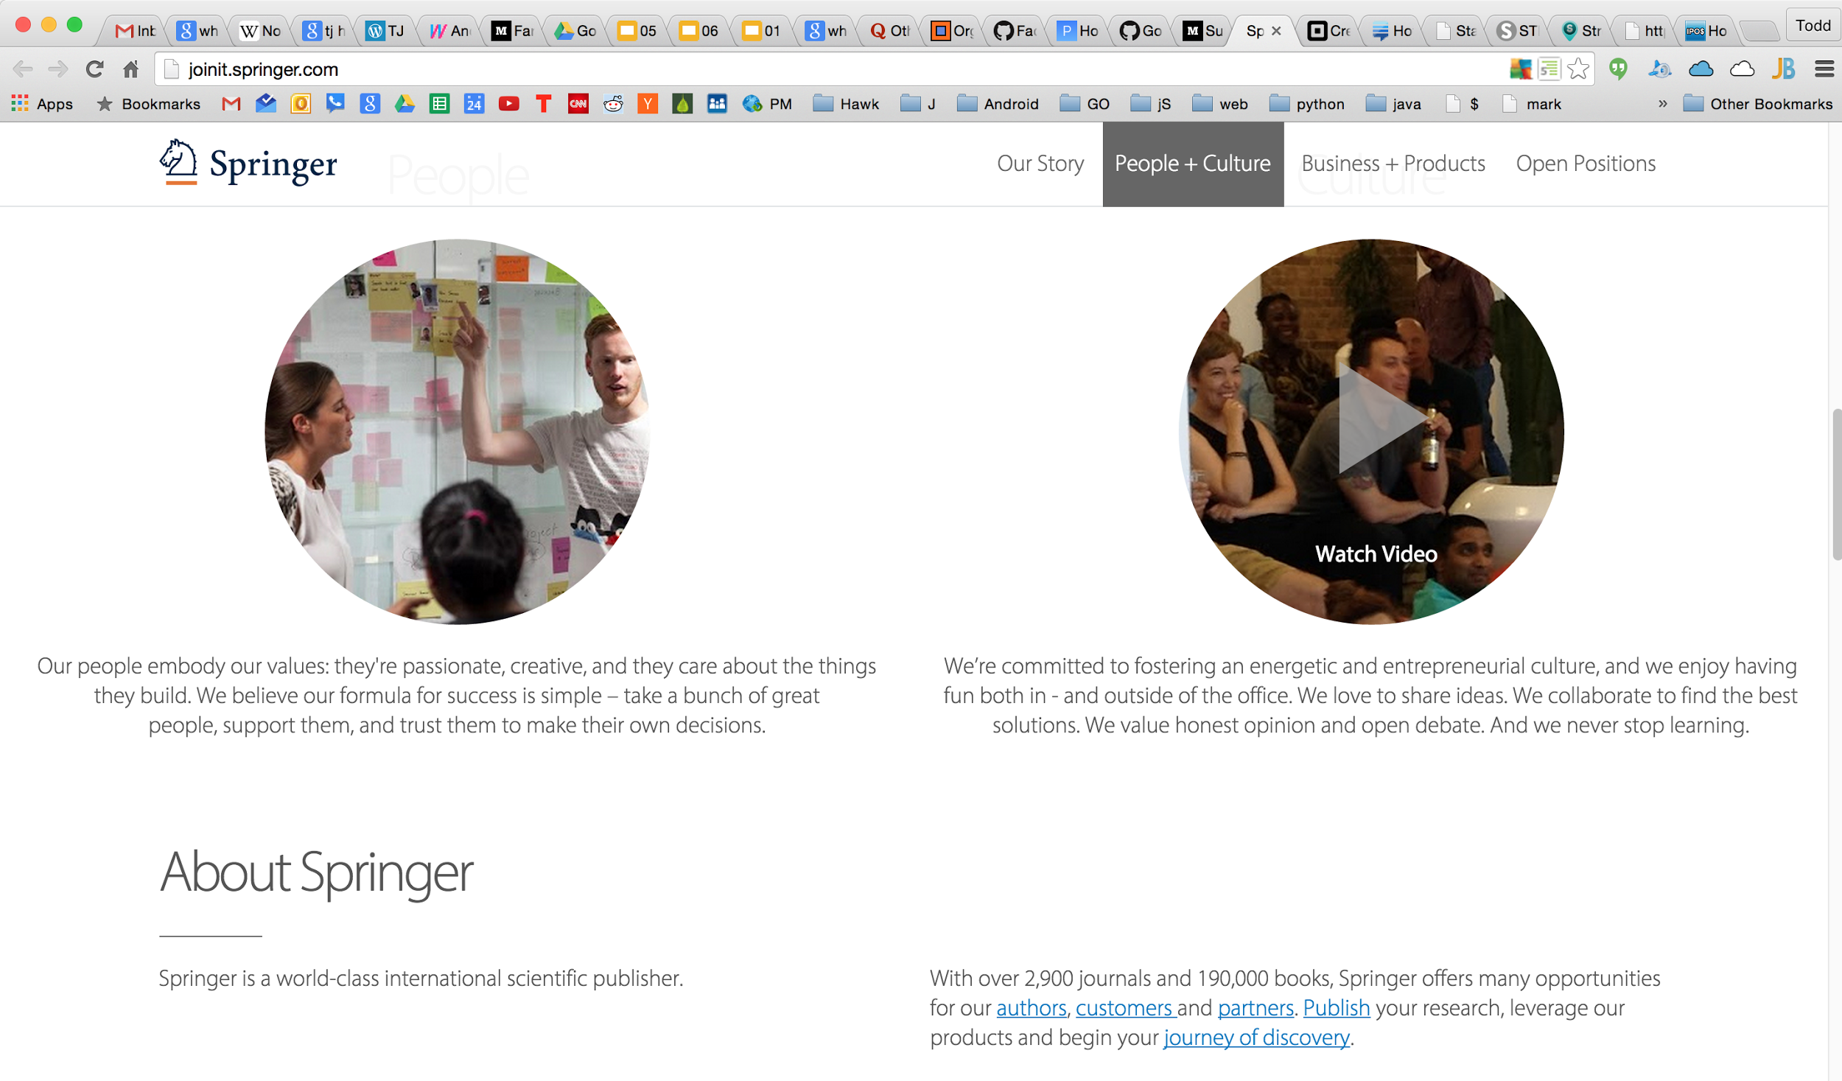

Slide 68
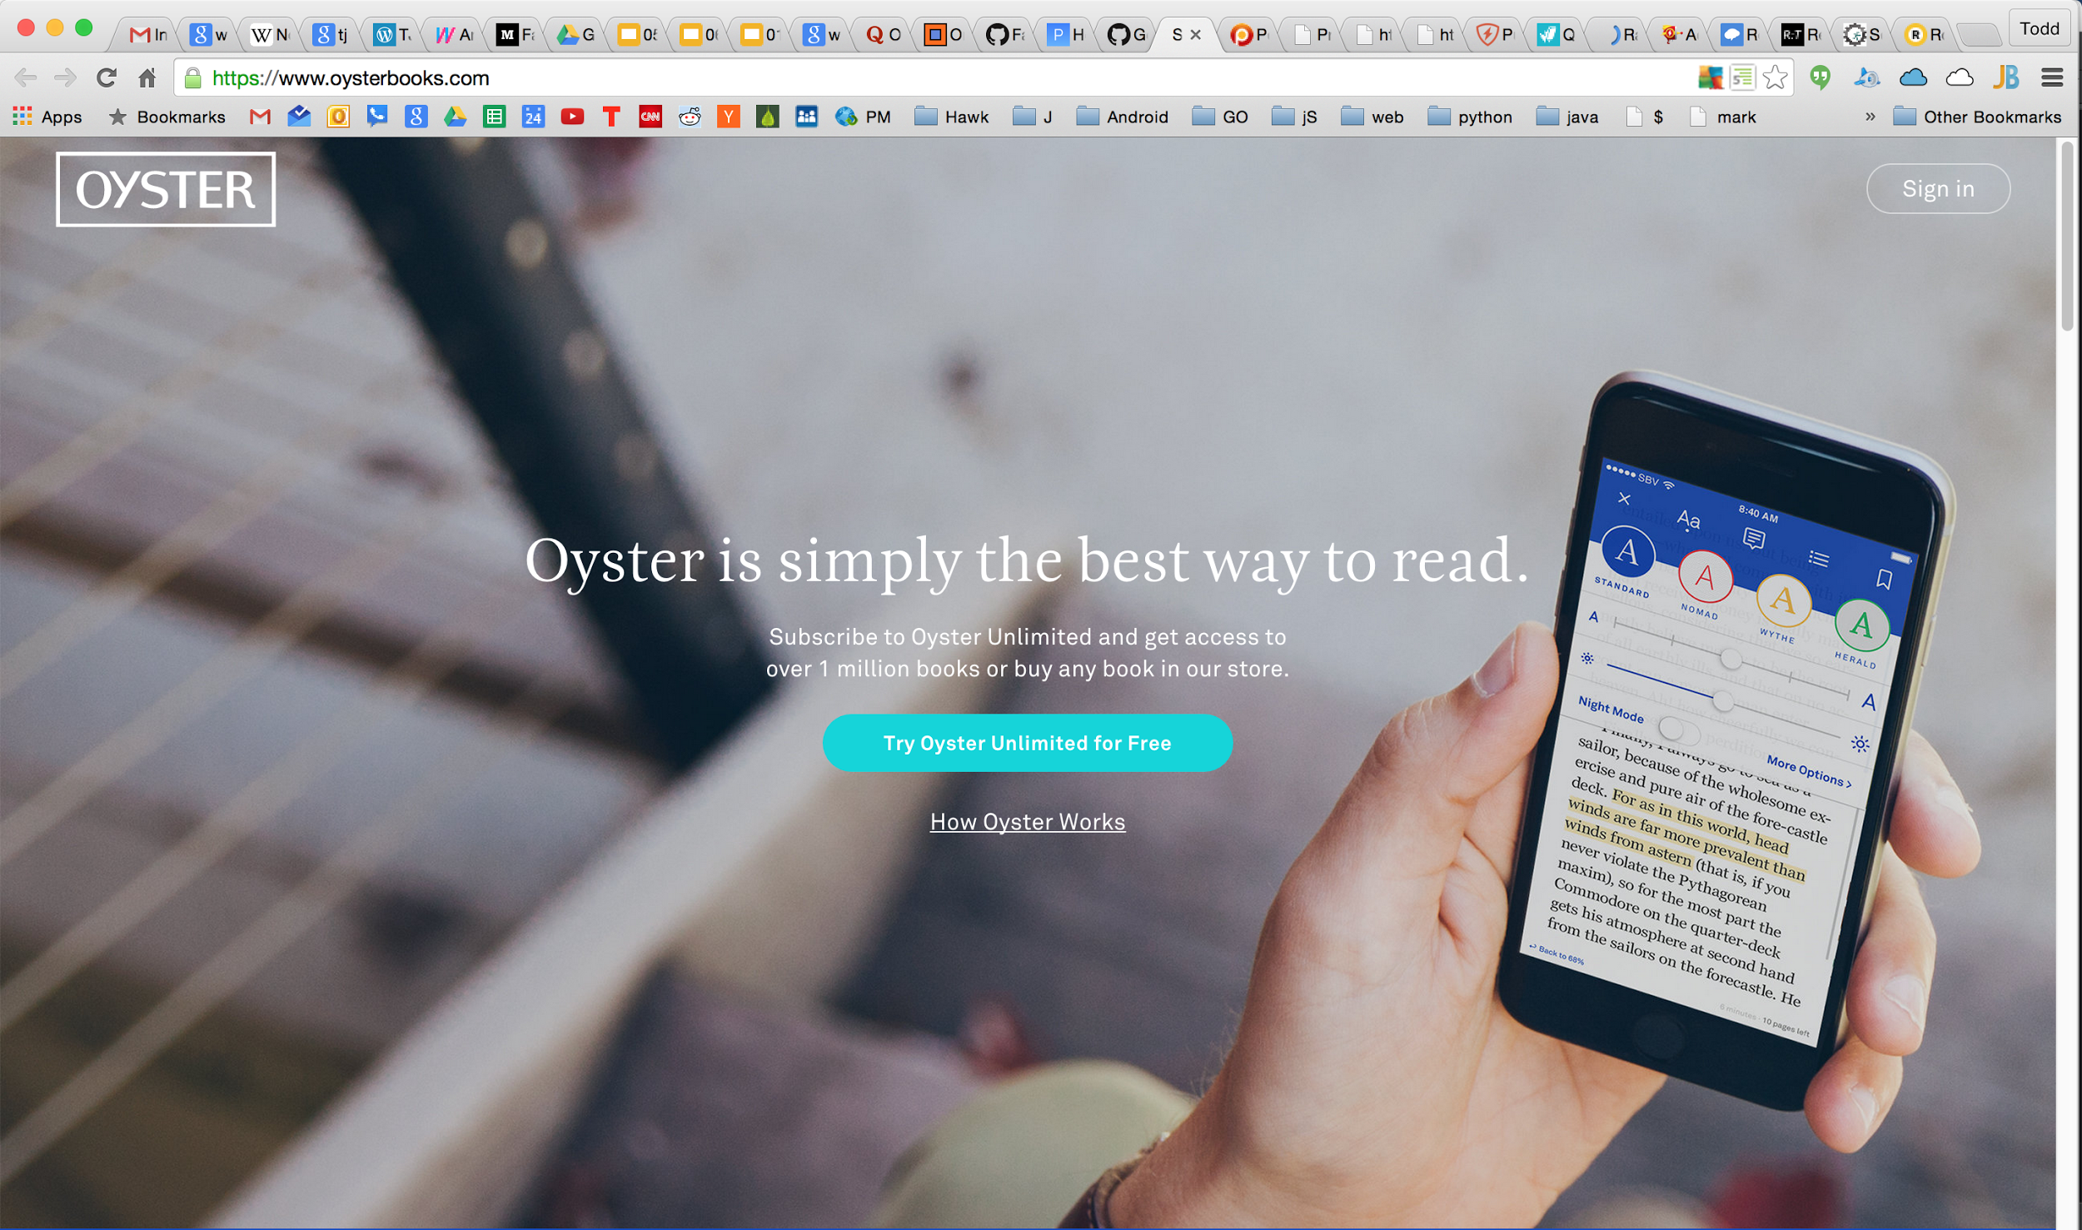

Slide 69
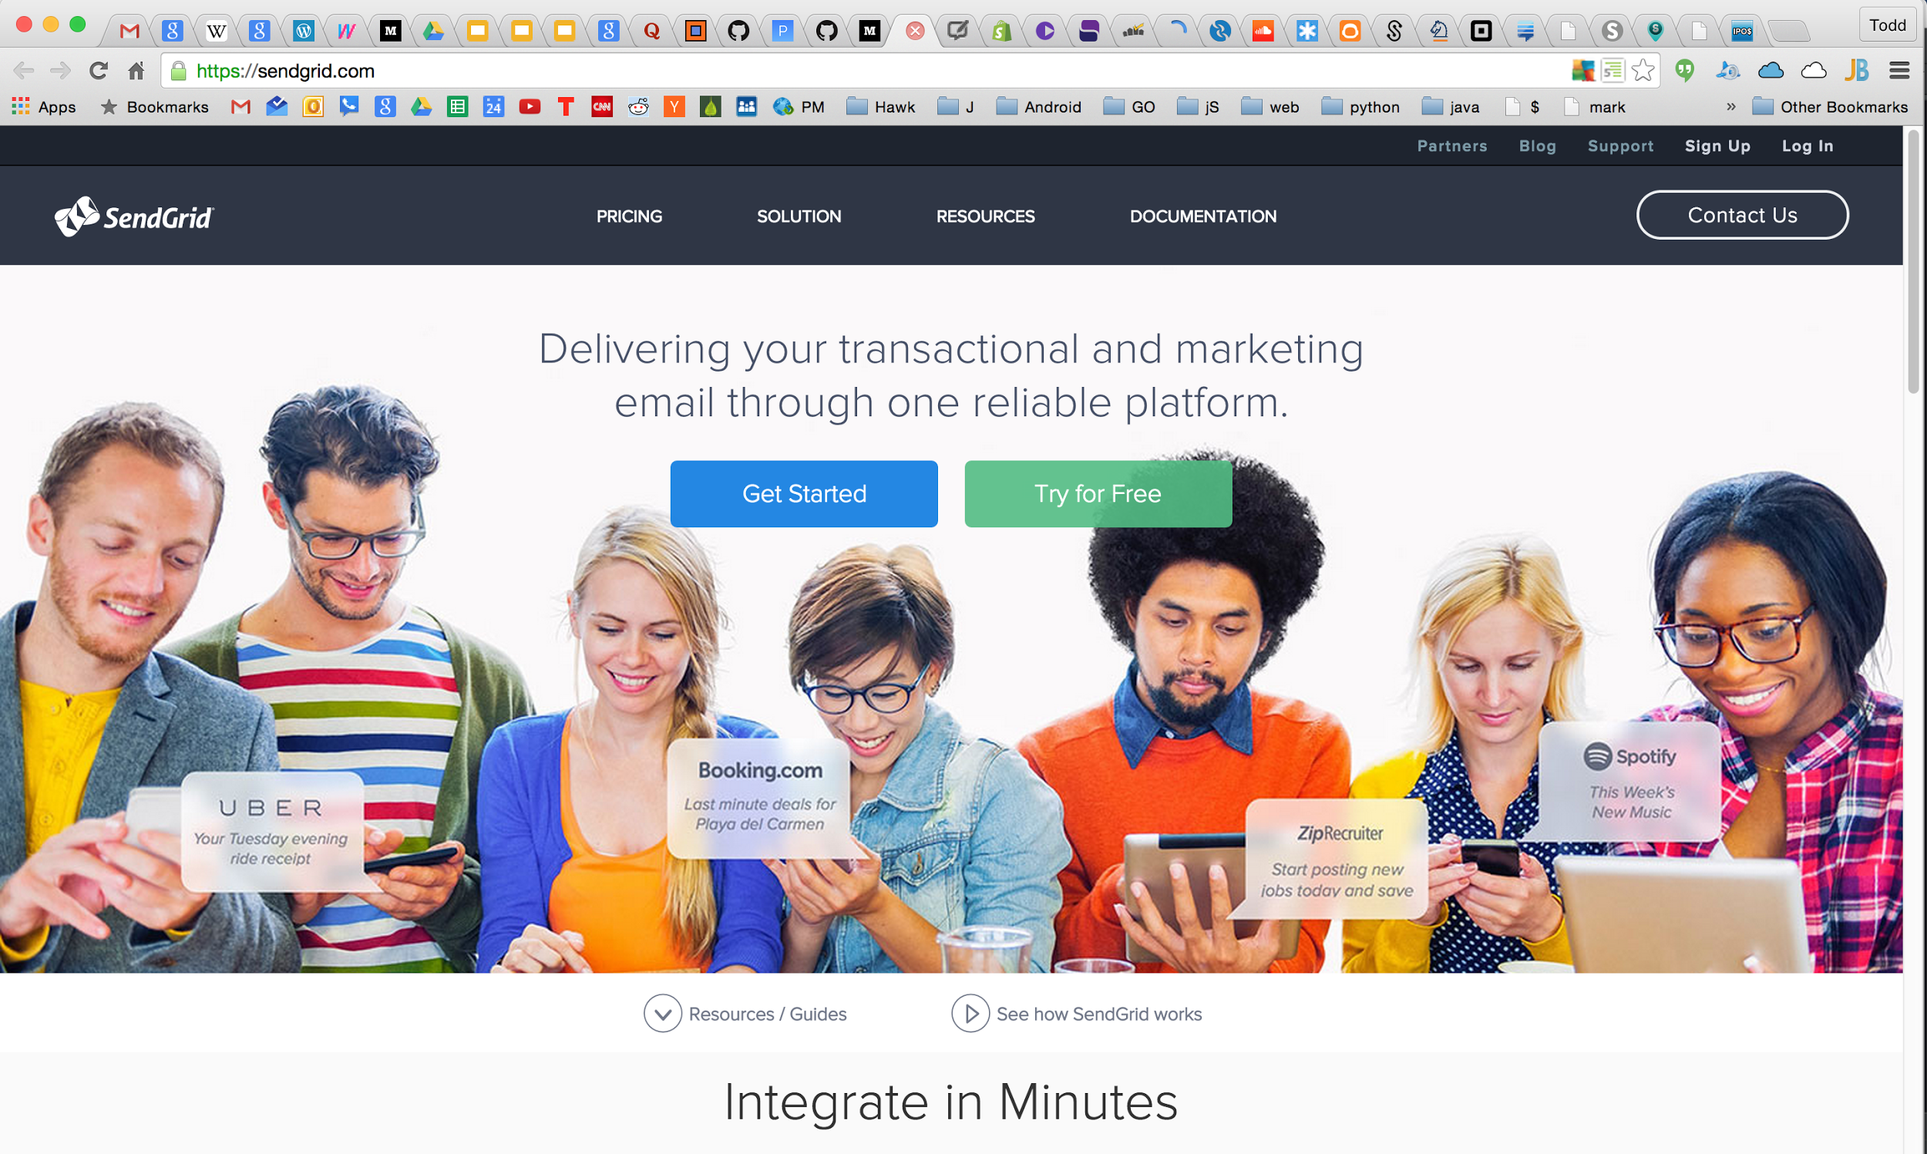

Slide 70


Slide 71
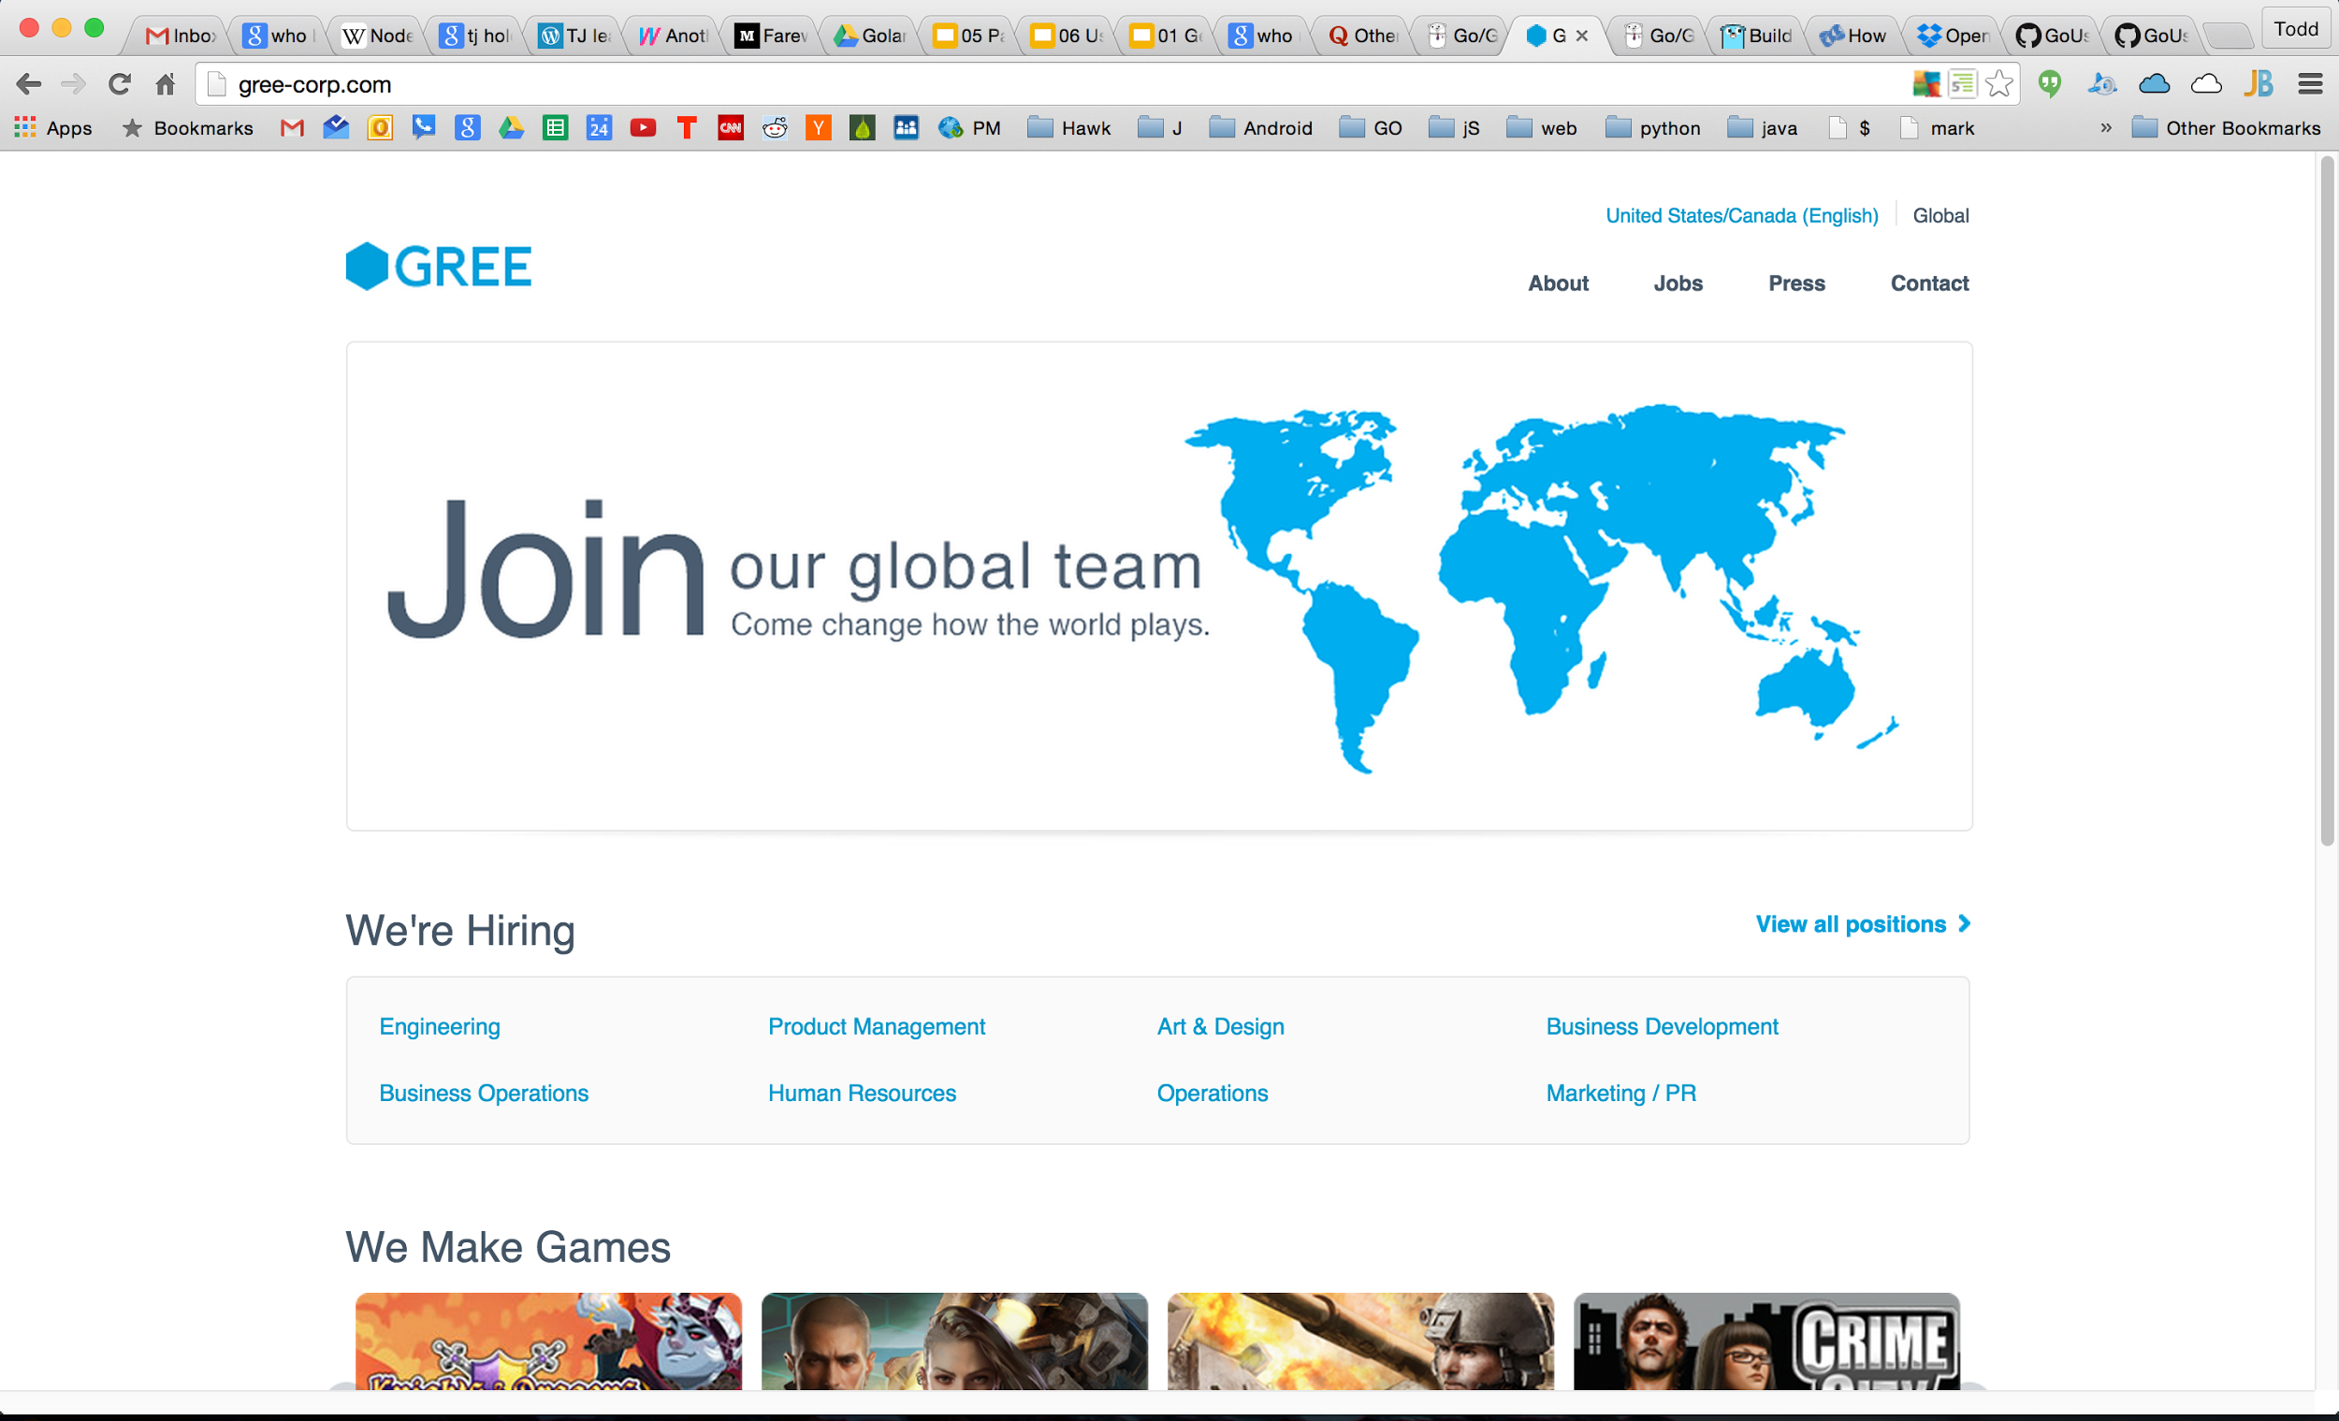

Slide 72
